Slide 1


Military Asset Reporting System
New Mexico Institute of Mining and Technology
Department of Electrical Engineering
Senior Design Class of 2018
Notes:
Tommy

Slide 2
Acknowledgements
Engineering Board
Project Manager
Dr. Scott Teare
Technical Advisors
Dr. Aly El-Osery, Dr. Anders Jorgensen, Dr. Seda Senay, Dr. Kevin Wedeward
Department Lab Manager
Chris Pauli
Departments
Department of Electrical Engineering
Notes:
Tommy and Courtney
I would like to give thanks to all the people that made our success possible:
Engineering Board: For taking time out of their busy schedules to come and hear about our work.
Dr. Teare: Our glorious leader who forced us all to grow up when none of us wanted too…
for his unending patience and advice in leadership and project management
Technical Advisors: For their guidance in approaching, and eventually solving this difficult problem
Department: For supporting us through our degrees here at tech

Slide 3
Presentation Outline:
Motivation & Background: 10 min
Subsystem Development: 15 min + 10 min Q&A (each)
Power Scavenging Team
Tag Development Team
Node Development Team
User Interface / Server Development Team
Integration, Testing, and Conclusions: 10 minutes + Q&A
Functional Demonstration
Notes:
Tommy
We expect to be in here for about two hours total with questions

Slide 4
Introduction
Courtney Bamonte, Nikita Belooussov, Thomas Dearing, Albert Reed
Notes:
With that, let’s get started,
Introduce yourself

Slide 5

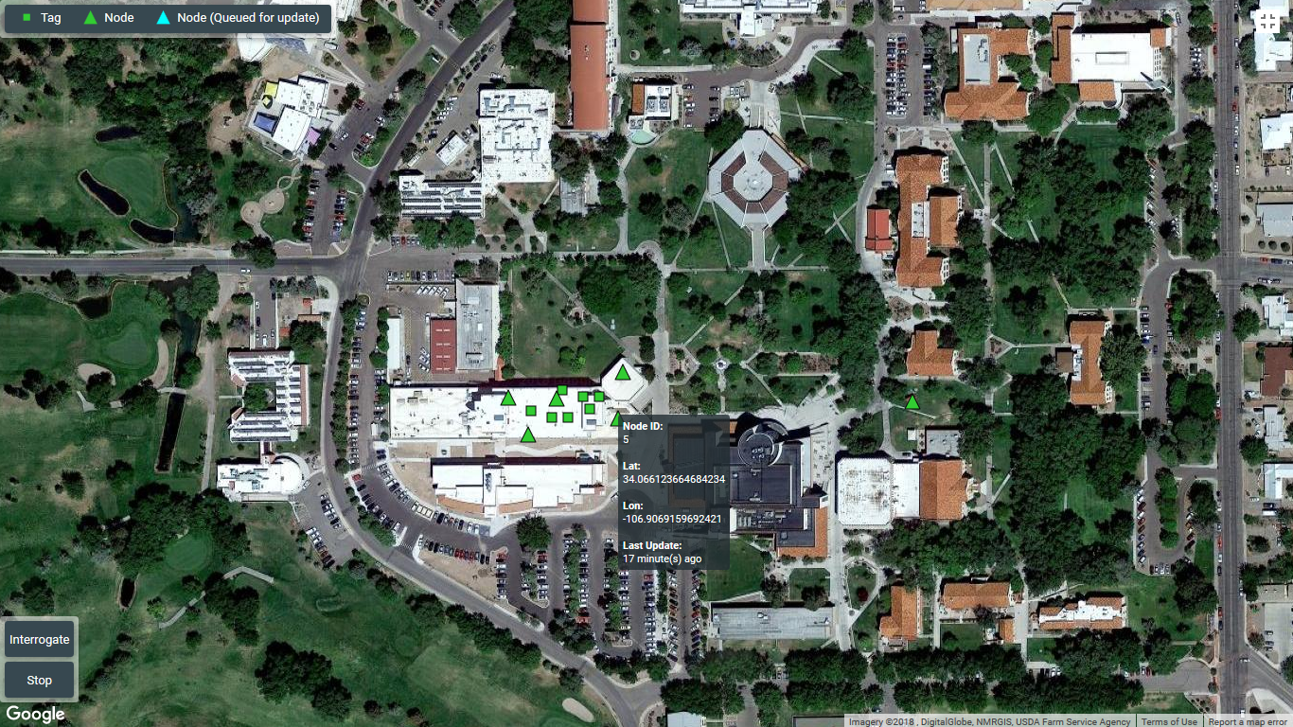
Motivation
Current military asset inventory procedures are...
Infrequent
Manually performed & recorded
Slow
Wasteful
Automated solutions exist for COTS retailers:
Static, or high maintenance installation
Critically vulnerable to attack
Neither are suited to Battlefield conditions
Notes:
Tommy
We were originally posed to investigate “some problem relating to IoBT”
Our initial investigations into current technologies revealed surprising details about current military procedures…
Commercial retailers do have solutions to this problem, but they are unsuited to a battlefield environment
Warehouse image
https://www.joc.com/international-logistics/industrial-real-estate/us-logistics-demand-accelerates-warehouse-absorption_20170427.html

Slide 6
Motivation
GOAL: An automated system to collect, receive, and interpret battlefield asset data
Required capabilities:
High mobility, scalability, and resilience on battlefield
Monitor at higher ranges than conventional RFID
Deliver asset position & time-of-measurement
Low maintenance and deployment cost
Desired capabilities:
Deliver information on other “local conditions”
Provide queryable user interface for specific assets
Notes:
Tommy

Slide 7
Design Challenges
Data integrity
Limited power availability
Long-range communications
Long operational lifetime
Device size limitations
Rapid response (Emergency)
Considerations omitted from this study:
Military systems, frequencies, or encryption
Notes:
Courtney

Slide 8
What is M.A.R.S.
A feasibility prototype of a Military Asset Reporting System, which will collect, interpret, and deliver battlefield asset data to the end-user.
Or…
A Supervisory Control and Data Acquisition (SCADA) system composed of a self-powered distributed data collection and sensor network
Notes:
Nikita

Slide 9
What is M.A.R.S.
A distributed sensor network approach is well suited to this application:
Distributed monitor hardware promotes:
Resilience to environmental damage
High scalability
Gradual deployment & low maintenance
Lower energy requirements
Automated database promotes:
High data integrity
Easy access from end-user
Notes:
Presenter: Nikita

Slide 10
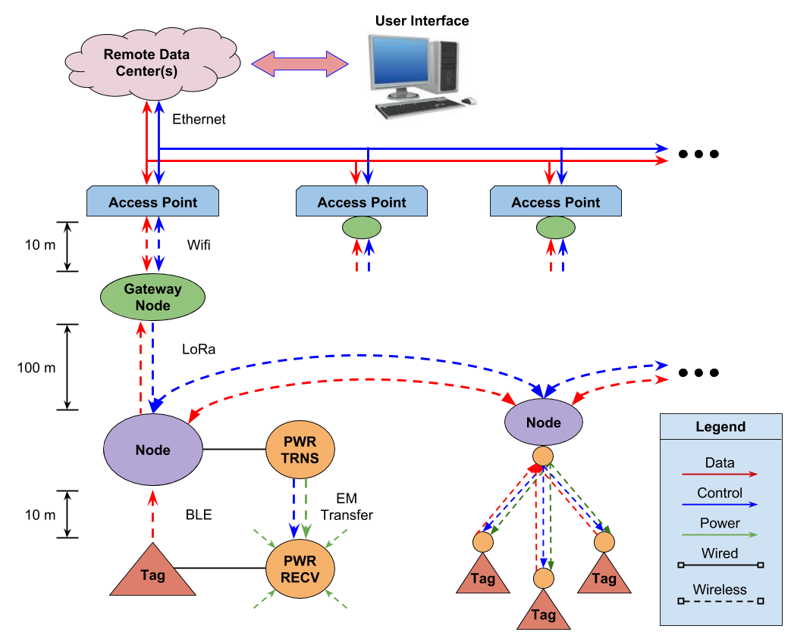
Design Overview: Subsystem Breakdown
Notes:
Courtney

Slide 11
Design Overview: Design Teams
Power Team
Tag Team
Node Team
UI/Server Team
Notes:
Everybody
“I took the role of Team leader for...”

Slide 12
Power Team
Power asset Tags
Offer means of Node interrogation
Notes:
Albert

Slide 13
Tag Team
Gather sensor data from tagged assets
Prep data for Node transmission
Notes:
Nikita

Slide 14
Node Team
Gather tag data
Add asset location and time
Packetize for network
Notes:
Tommy

Slide 15
UI/Server Team
Provide means of communication across nodes
Update server with data from network
Display information and initiate interrogation from UI
Notes:
Courtney

Slide 16
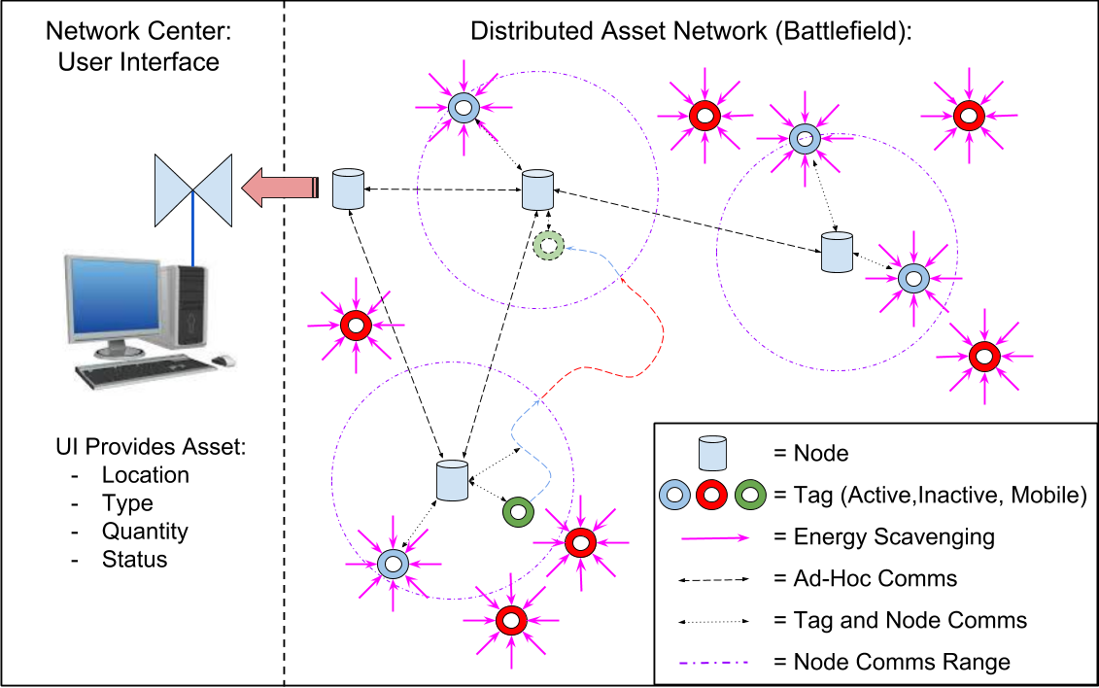
MARS Concept of Operation: Active Tag RFID
Notes:
Albert
Finite range on nodes n tags

Slide 17
Application Specifications
Specification | Value | Description
Communications Range | To Tags: 10 m To Nodes: 100 m To Gateway: 100 m | Minimum operating range
Maintenance Period | Tags: > 1 year Nodes: > 1 shift | Minimum time before Node/Tag recharge
Monitor Update Period | Normal: 1 hr Emergency: 5 min | Minimum inventory update period
Scalability | 100 Tags & Nodes | Minimum number of connections per Node
Server Scalability | 100 Tags per Node 100 Nodes | Minimum number of connected devices server can handle
Positioning Error | < 10 m | Minimum location error for monitored assets
Notes:
Tommy
Word choice for comms range specs: “provided as challenge specs to meet for the application”
All others have justifications from application

Slide 18
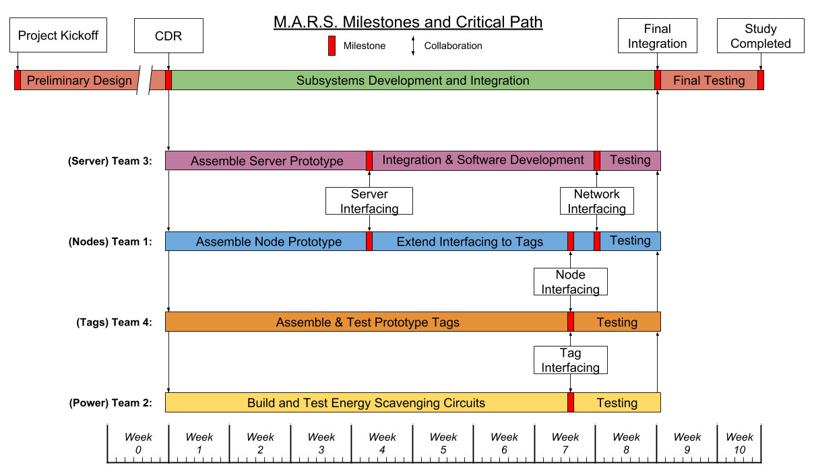
Timeline & Budget
Project Timeline:
Design Phase (14 Weeks)
Prototype Phase (11 Weeks)
Hardware Budget:
$4000
Notes:
Albert

Slide 19
Power Team
Jaclyn Chang, Ricardo Del Toro, Delos Edick, Vincent Grap, Albert Reed, Jacob Schmelzel
Notes:
Albert

Slide 20
Subsystem Introduction: Power Scavenging
MARS is a Supervisory Control and Data Acquisition (SCADA) system composed of a self-powered distributed data collection and sensor network.
The Power Subsystem uses energy scavenging to provide power to the tags.
Notes:
Albert

Slide 21
Full System Model
Notes:
Albert

Slide 22
Power Subsystem
Notes:
Albert

Slide 23
Subsystem Specifications
Specification | Value | Description
Power Transfer Range | > 10 m | Minimum requirement to supplement node to tag comms
Average Power | > 4.8 uW | Minimum average power to keep tags operational indefinitely
Notes:
Presenter: Albert
How these specifications derived from the research tag team did on minimum power consumed by MCU with TX/RX

Slide 24
Power Sources Decision Matrix
Power Source | Environmental Versatility Rating | Power Production Vs. Size of Unit | Feasibility for Tag Integration | Total
EM Scavenging | 7 | 8 | 9 | 91
Thermal Energy Harvesting Unit | 2 | 4 | 3 | 32
Piezoelectric | 4 | 8 | 9 | 80
Inductive Coupling | 1 | 8 | 1 | 33
Magnetic Resonance | 2 | 8 | 1 | 35
Solar | 6 | 10 | 7 | 88
Weight (1-5) | 5 | 3 | 4
Notes:
Presenter: Ricardo
Possible questions that will be asked: how did you assign/determine numerical ratings

Slide 25
Power Storage Unit Decision Matrix
Storage Type | Size | Storage Capacity | Lifetime | Maintenance Rating | Total
None | 10 | 0 | 0 | 0 | 10
Capacitor | 9 | 1 | 10 | 2 | 88
Rechargeable Battery | 6 | 10 | 5 | 8 | 109
Non-Rechargeable Battery | 6 | 10 | 0 | 5 | 78
Weight (1-5) | 3 | 5 | 5 | 2
Notes:
Presenter: Jaclyn
None: in the case enough power would be transmitting to the tags at all times
Capacitors:
Pros: short charging times, long cycle life, temperature performance
Cons: high self discharge
Batteries:
Pros: Storage capacity, power density, constant voltage that can be turned on/off
Cons: long charging times, more temperature sensitive compared to capacitors
Non-Rechargeable: inexpensive, (secondary power source)

Slide 26
Engineering Standards & Ethical Considerations
FCC Regulations on ISM Communication Bands
Frequency | Maximum Transmitter Output Power | Antenna Gain | Effective Isotropic Radiated Power (EIRP)
902 - 928 MHz | 30 dBm (1 W) | 6 dBi | 36 dBm (4 W)
2.400 - 2.4835 GHz | 30 dBm (1 W) | 6 dBi | 36 dBm (4 W)
5.725 - 5.875 GHz | 30 dBm (1 W) | 6 dBi | 36 dBm (4 W)
Notes:
Presenter: Vincent
We down selected to 900MHz due to its lower attenuation compared to the other frequencies

Slide 27
Engineering Standards & Ethical Considerations
Safety Concerns: FCC Limits for Maximum Permissible Exposure
Limits for Exposure | Power Density @ 900 Mhz (S = mW/cm²) | Average Exposure Time
Occupational/Controlled | S = 3 | 6 Minutes
General Population/Uncontrolled | S = 0.6 | 30 Minutes
Our Parameters:
Transmitted Power - 1 Watt at 30dBm
Antenna Gain - 5dBi
Notes:
Presenter: Vincent
At 3cm away from our transmitter, that is the same power density as someone holding a cellphone up to their head

Slide 28
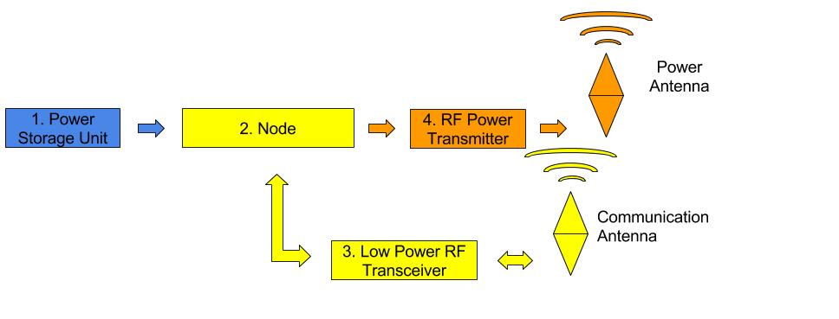
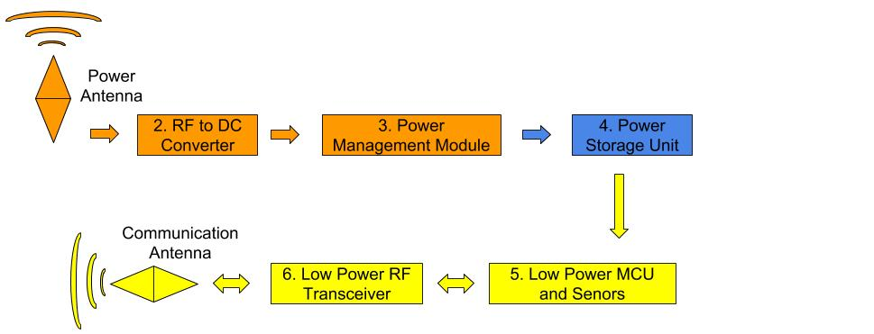
Power Transmission
Notes:
Jacob
Important thing to mention:
Design for DC power to RF transmission
Design for RF to usable DC power

Slide 29
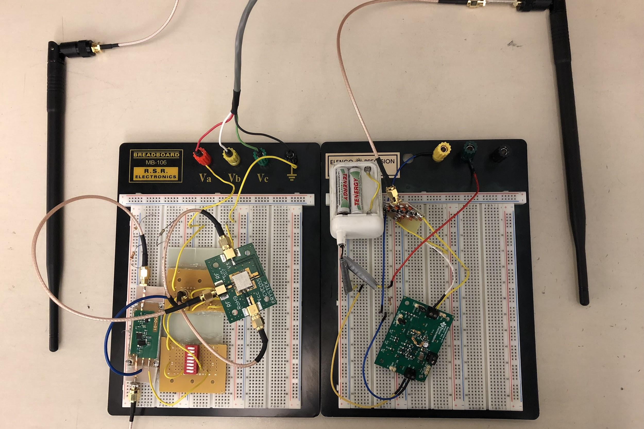
Power Transmission Circuitry
Transmitter
Receiver
Notes:
Jacob
Finished system
Node left
Tag right

Slide 30
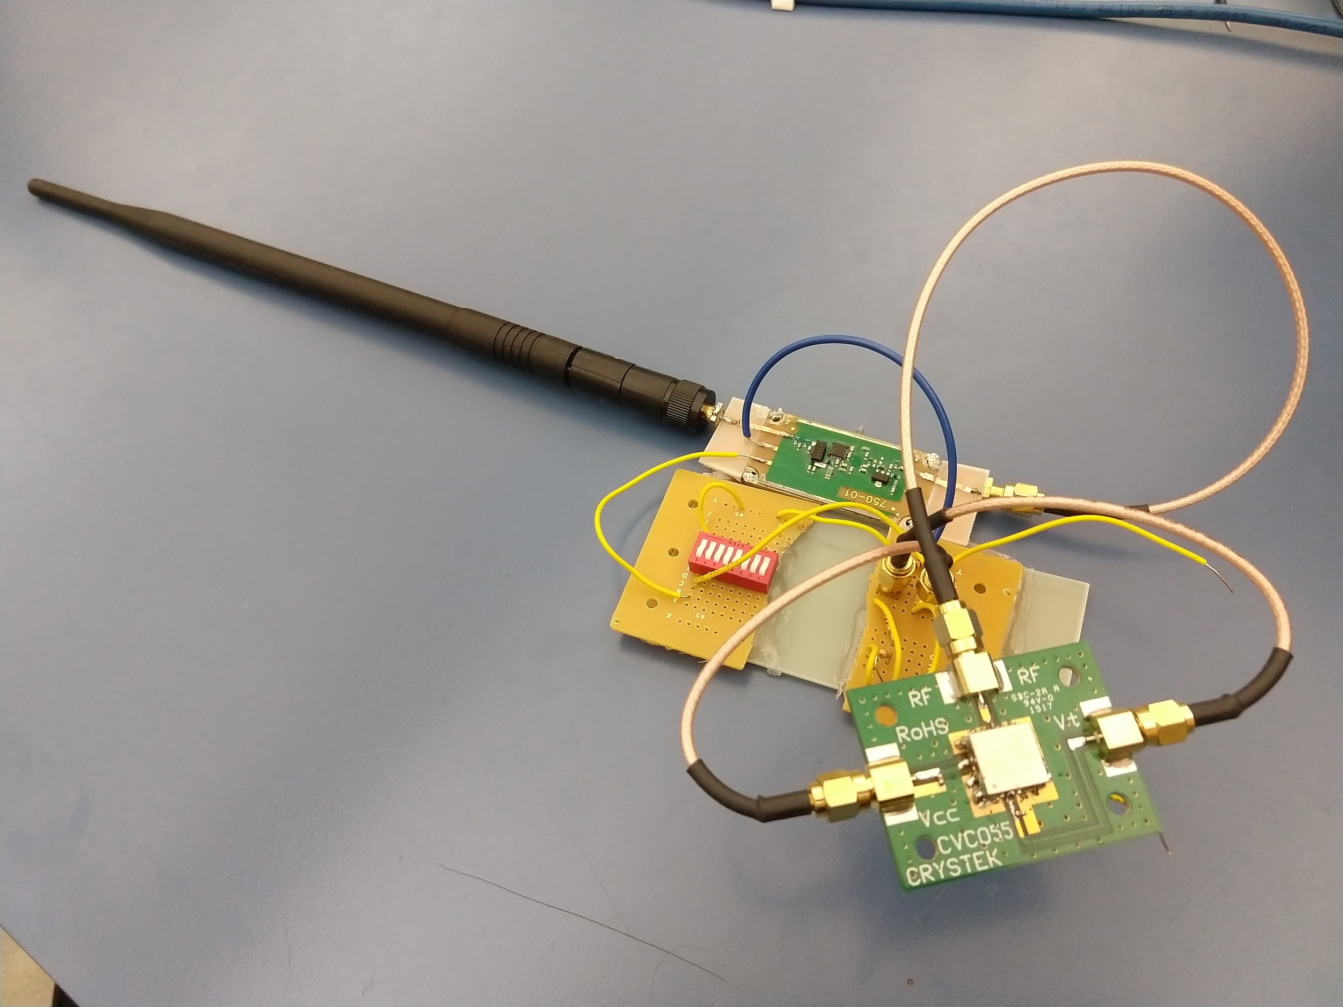
Power Transmission Circuitry
Amplifier
Voltage controlled oscillator
Notes:
Jacob
For rf power transmitter:
Voltage controlled oscillator to…
30 db amplifier to…
910 mhz 50 ohm antenna

Slide 31
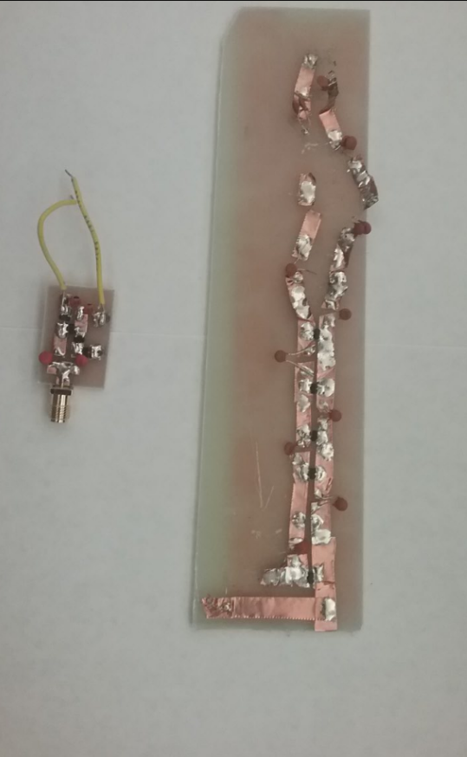
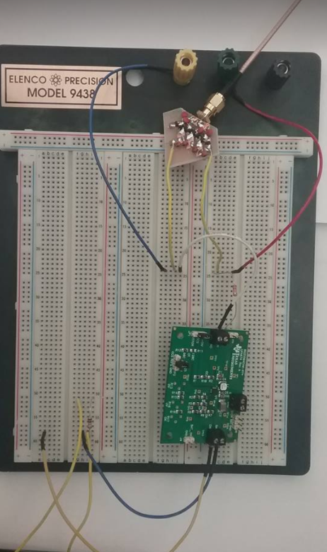
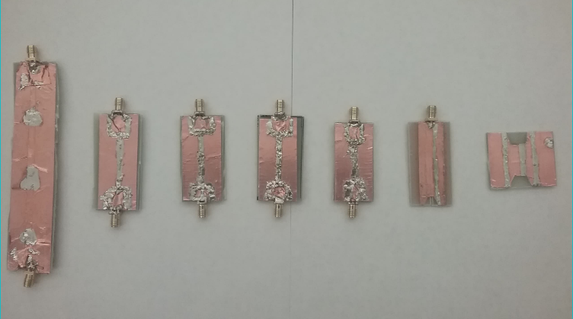
Power Receiver Circuitry
Notes:
Jacob
Compare to research papers
50 ohm antenna to…
Impedance matching for the capacitve rf to dc with microstrip line to…
Rf to dc (dickson multiplier)...
Battery management board COTS part for low power charging system
Maximum Power Point Tracking

Slide 32
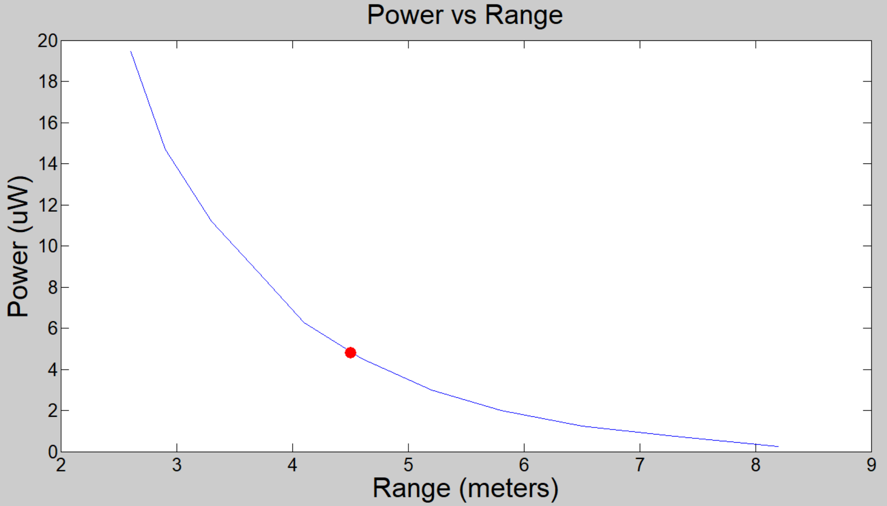
Results: Power vs. Range
Range: 4.5 m, Power: 4.8 uW
Notes:
Delos
Maximum Power Point Tracking (MPPT)

Slide 33
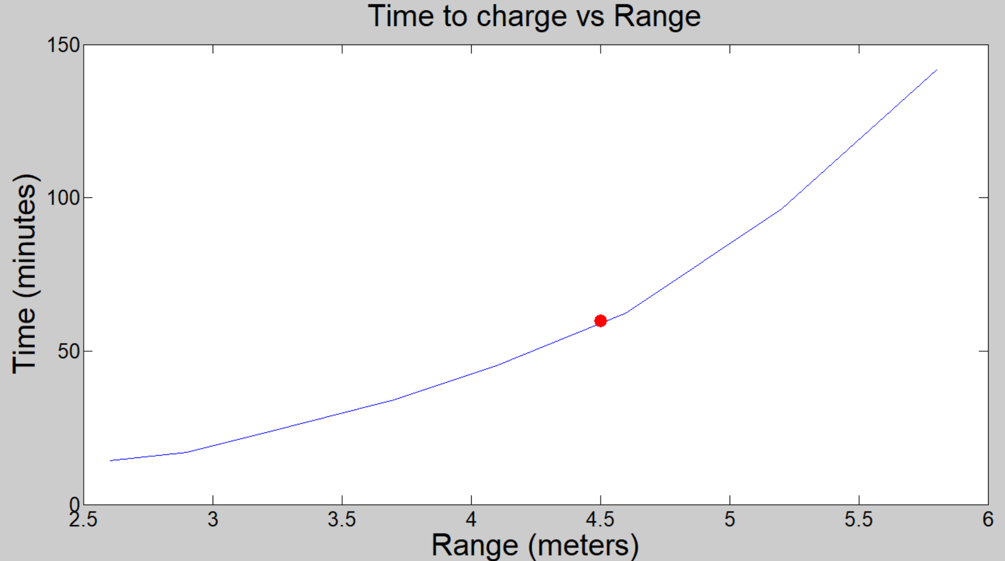
Results: Distance vs. Time to Replace 17 mJ
Time: 60 min
Range: 4.5 m
Notes:
Delos

Slide 34
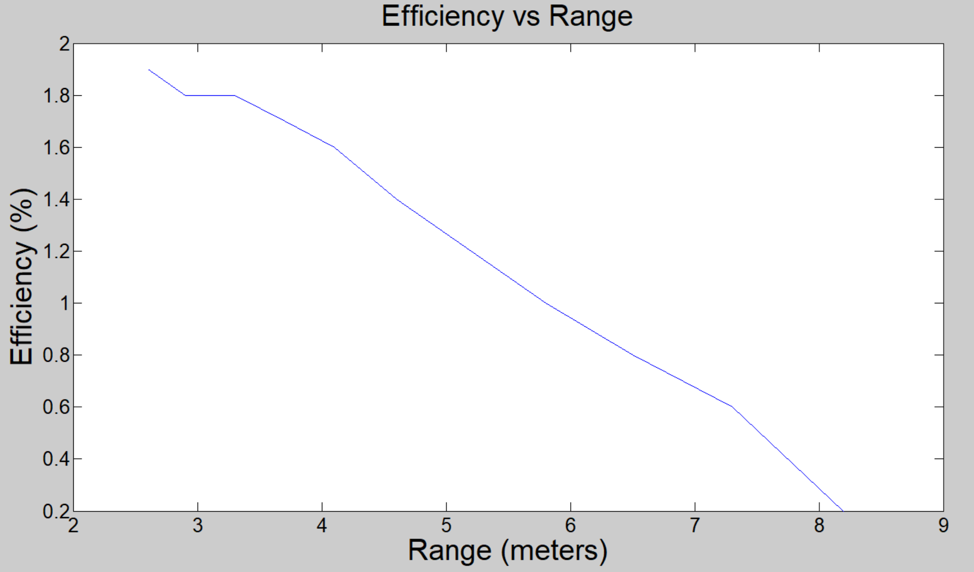
Results: Efficiency vs. Range
Notes:
Delos

Slide 35
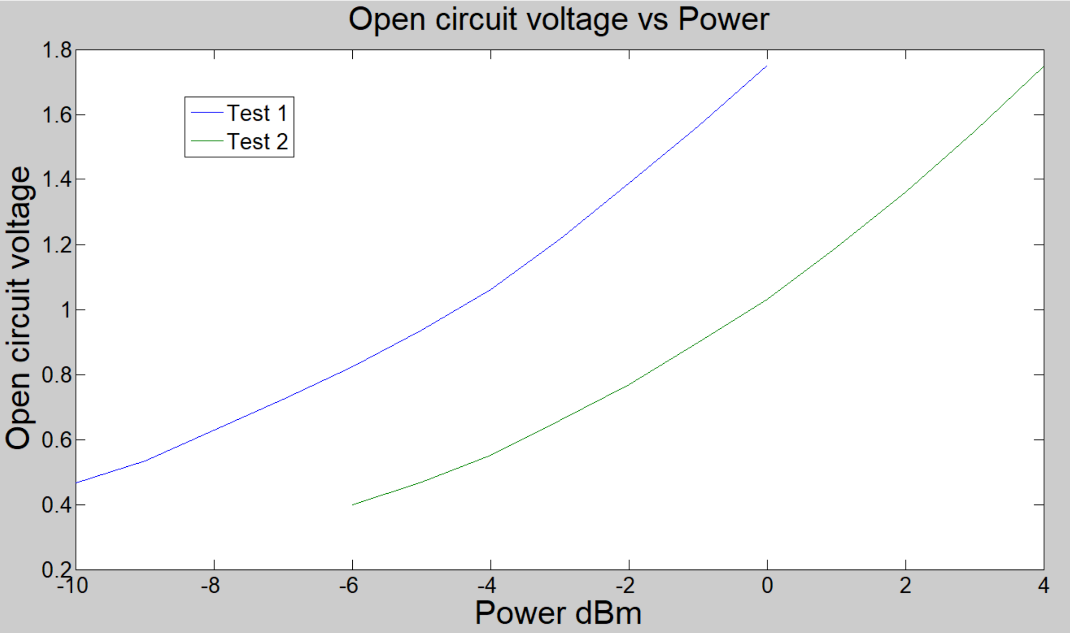
Results: Open Circuit Voltage vs. Power
Notes:
Delos

Slide 36
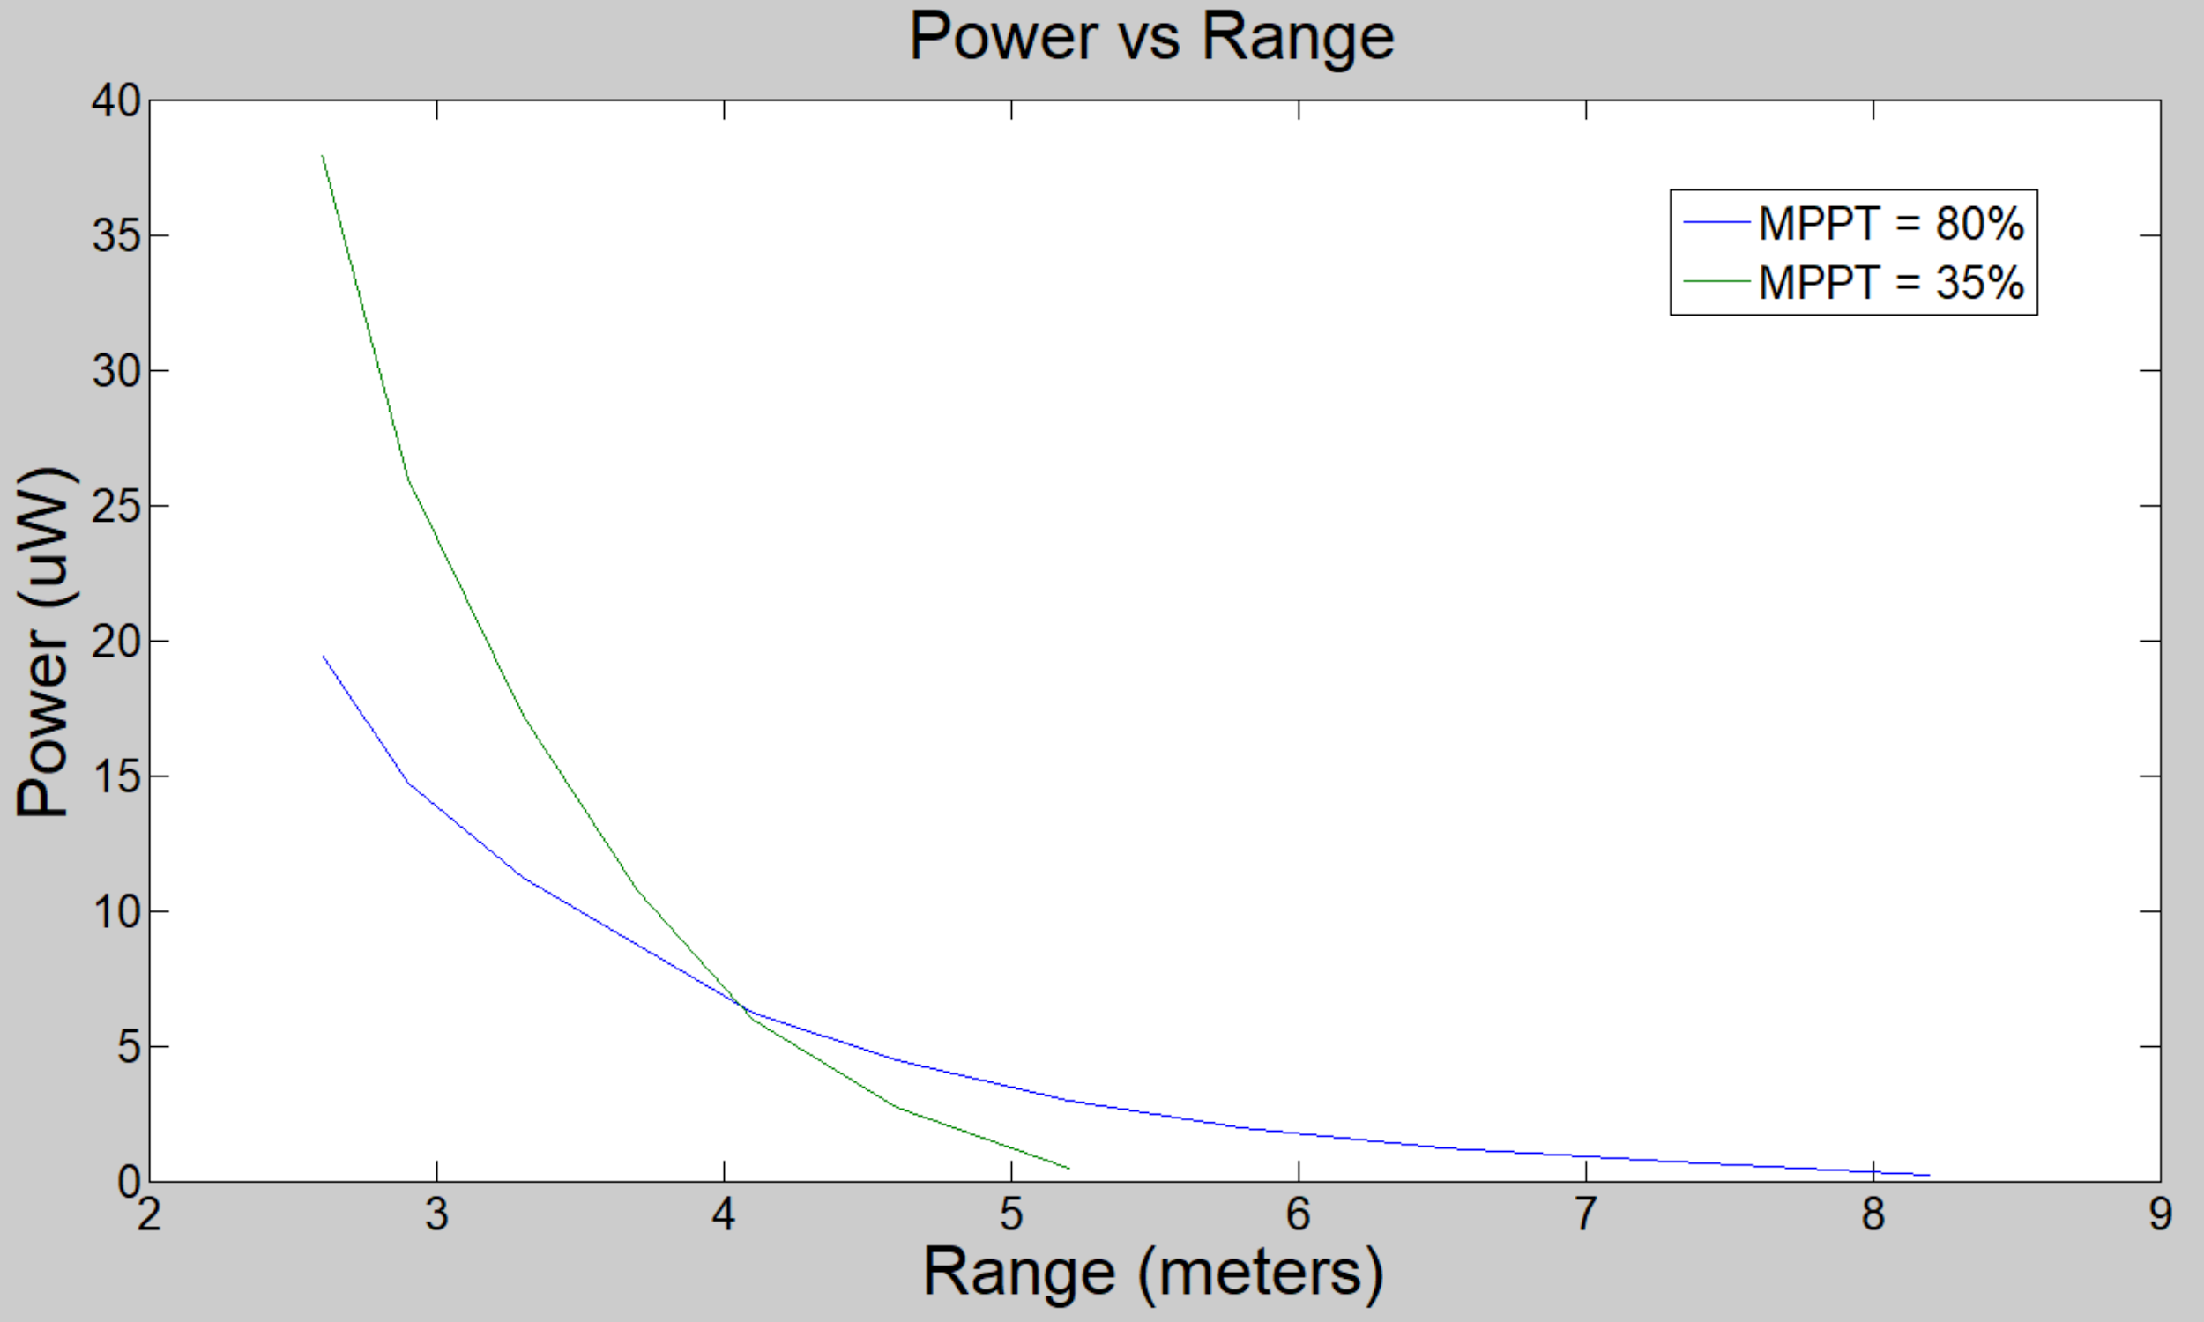
Results: Improved Power vs. Range
Notes:
Delos

Slide 37
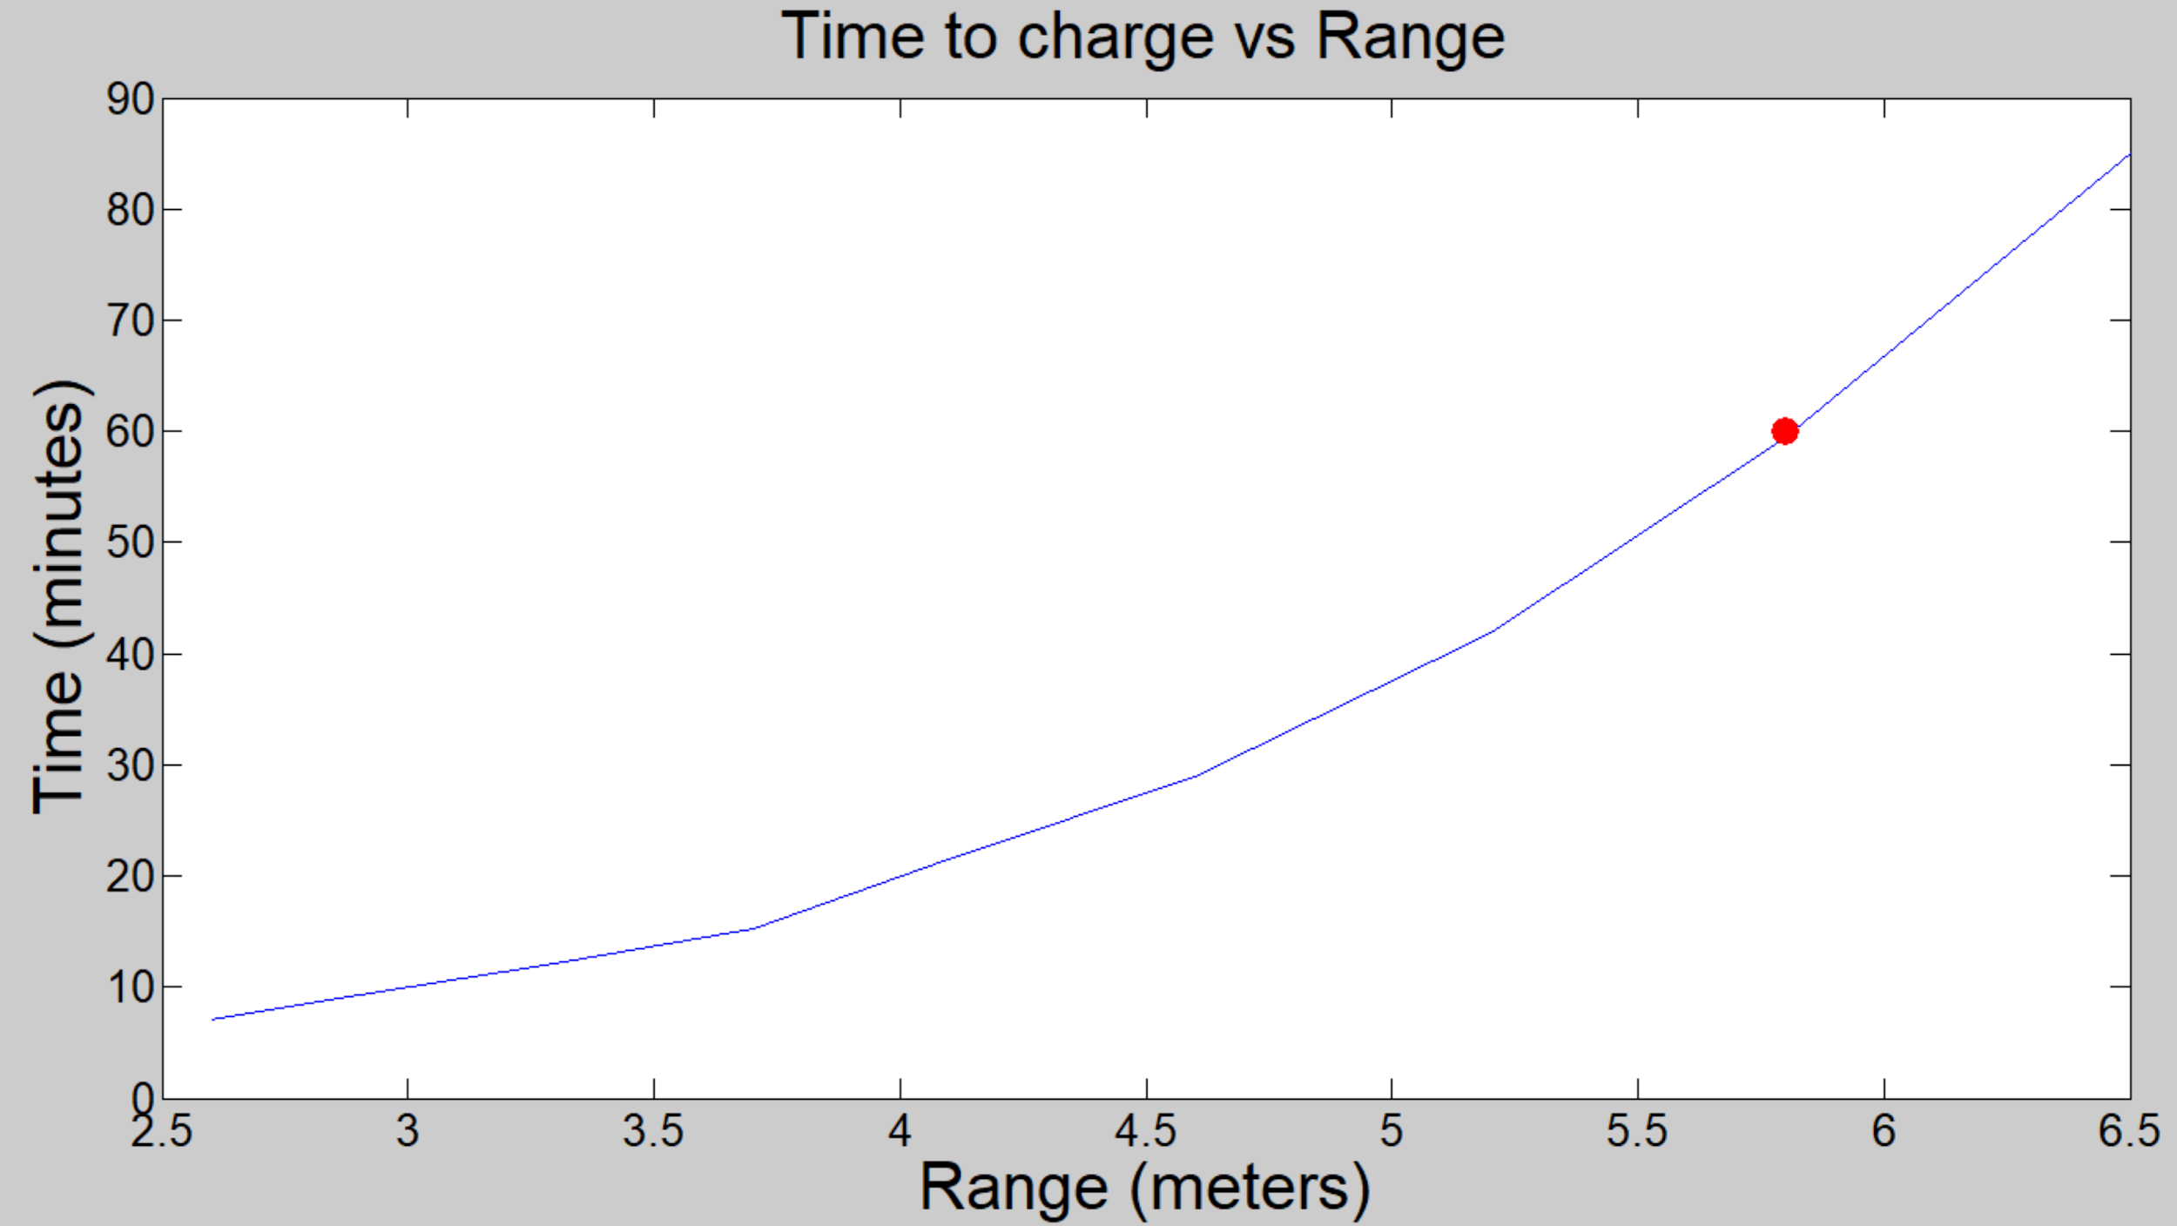
Results: Charging Time vs. Range
Notes:
Delos

Slide 38
Results: Efficiency
 | Measured Section Losses | Total Power Delivered after each Stage (Overall Efficiency)
Reflection | 10% | 90%
Cable losses | 10% | 81%
Multiplier | 95% | 4%
Battery management | 50% | 2%
Notes:
Efficiency of systems @ 10 meter distance
Vincent

Slide 39
Results: Simulation vs. Measured
Transmitted Power:
30 dBm
< 0.6 mW/cm²
Power Transfer Efficiency:
Replenish TX Power Usage (17 mJ) < 60 min
Maximum Range: 4.5 meters
Problems:
Multiplier circuit requires new diodes
Efficiency issues due to cheap construction
Resolutions:
Rebuild multiplier circuit with new diodes
Integrate new multiplier circuit with MPPT
More accurate capacitor values
Notes:
Albert

Slide 40
Skills and Technical Innovations
Skills Developed
Iterative Design
Multisim Simulations
High Frequency Circuit Fabrication
RF Test Equipment: Spectrum Analyzer, Vector Network Analyzer
Etching a PCB
Innovations Implemented
RF power transfer with 3 volt minimum threshold
Inexpensive solution to RF power transfer
Notes:
Presenter: Jaclyn
Presenter: Ricardo

Slide 41
Questions?

Slide 42
Tag Team
Nikita Belooussov, Nathaniel Freeman, Austin Rudolph, Enrique Sandoval, Matthew Sandoval
Notes:
Presenter: Nikita

Slide 43
Subsystem Introduction: Tags
MARS is a Supervisory Control and Data Acquisition (SCADA) system composed of a self-powered distributed data collection and sensor network.
Tags are attached to valuable military assets, provide identification and sensor data at least 10 meters from nodes, and respond to asset interrogation signals.
Notes:
Presenter: Austin
Provide example

Slide 44
Subsystem as Part of Overall System
Notes:
Presenter: Austin

Slide 45
Subsystem as Part of Overall System
Notes:
Presenter: Austin

Slide 46
Subsystem Specifications
Specification | Value | Description
Communication Range | > 10 m | Minimum tag-to-node operating range
Power | < 5 𝜇W | Maximum average power usage
Scalability | > 100 tags | Minimum tags each node can gather data from
Emergency Interrogation Signal | < 5 min | Maximum interrogation response time
Notes:
Presenter: Austin

Slide 47
Decision Matrix: Communication Type
 | Range | Practicality | Interference | Total
Radio Frequency | 9 | 10 | 5 | 100
Light | 5 | 7 | 8 | 77
Wired Connection | 6 | 4 | 9 | 73
QR | 3 | 7 | 8 | 67
Sound | 3 | 2 | 3 | 32
Weight (1-5) | 5 | 4 | 3
Notes:
Presenter: Nate

Slide 48
Decision Matrix: Communication Protocol
 | Power | Range | Max Connections | Availability | Total
Bluetooth Low Energy | 10 | 7 | 8 | 10 | 126
Zigbee | 9 | 8 | 9 | 8 | 121
Dash 7 | 8 | 9 | 10 | 3 | 107
ANT | 9 | 7 | 9 | 4 | 107
Wifi | 4 | 10 | 7 | 9 | 95
Thread | 7 | 7 | 7 | 4 | 89
LoRaWan | 7 | 10 | 6 | 3 | 88
Weight (1-5) | 5 | 2 | 4 | 3
Notes:
Presenter: Nate

Slide 49
Decision Matrix: Microcontroller
 | Required Current | Required Voltage | Availability | Price | Total
PIC16F1708 | 10 | 10 | 5 | 10 | 150
ATTiny84 | 6 | 10 | 10 | 8 | 144
PIC16F877 | 2 | 5 | 5 | 7 | 76
Weight (1-5) | 5 | 5 | 4 | 3
Notes:
Presenter: Nate

Slide 50
Engineering Standards & Ethical Considerations
Communications Protocols:
Bluetooth standards (IEEE 802.15.1)
Emissions Safety Regulations:
WBAN compliant (IEEE 802.15.6)
FCC frequencies and power
Notes:
Presenter: Nate

Slide 51

Tag Design Approach
Node
Antenna
Interrogation
Pin Interrupt
BLE
Module
Power
PIC
Notes:
Presenter: Matt

Slide 52
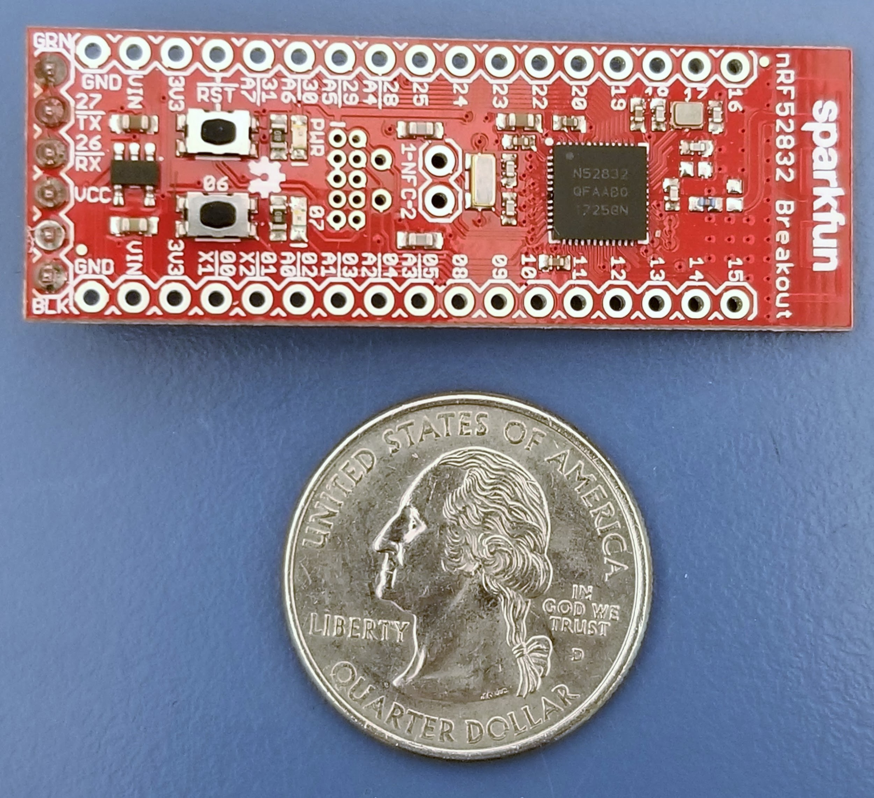
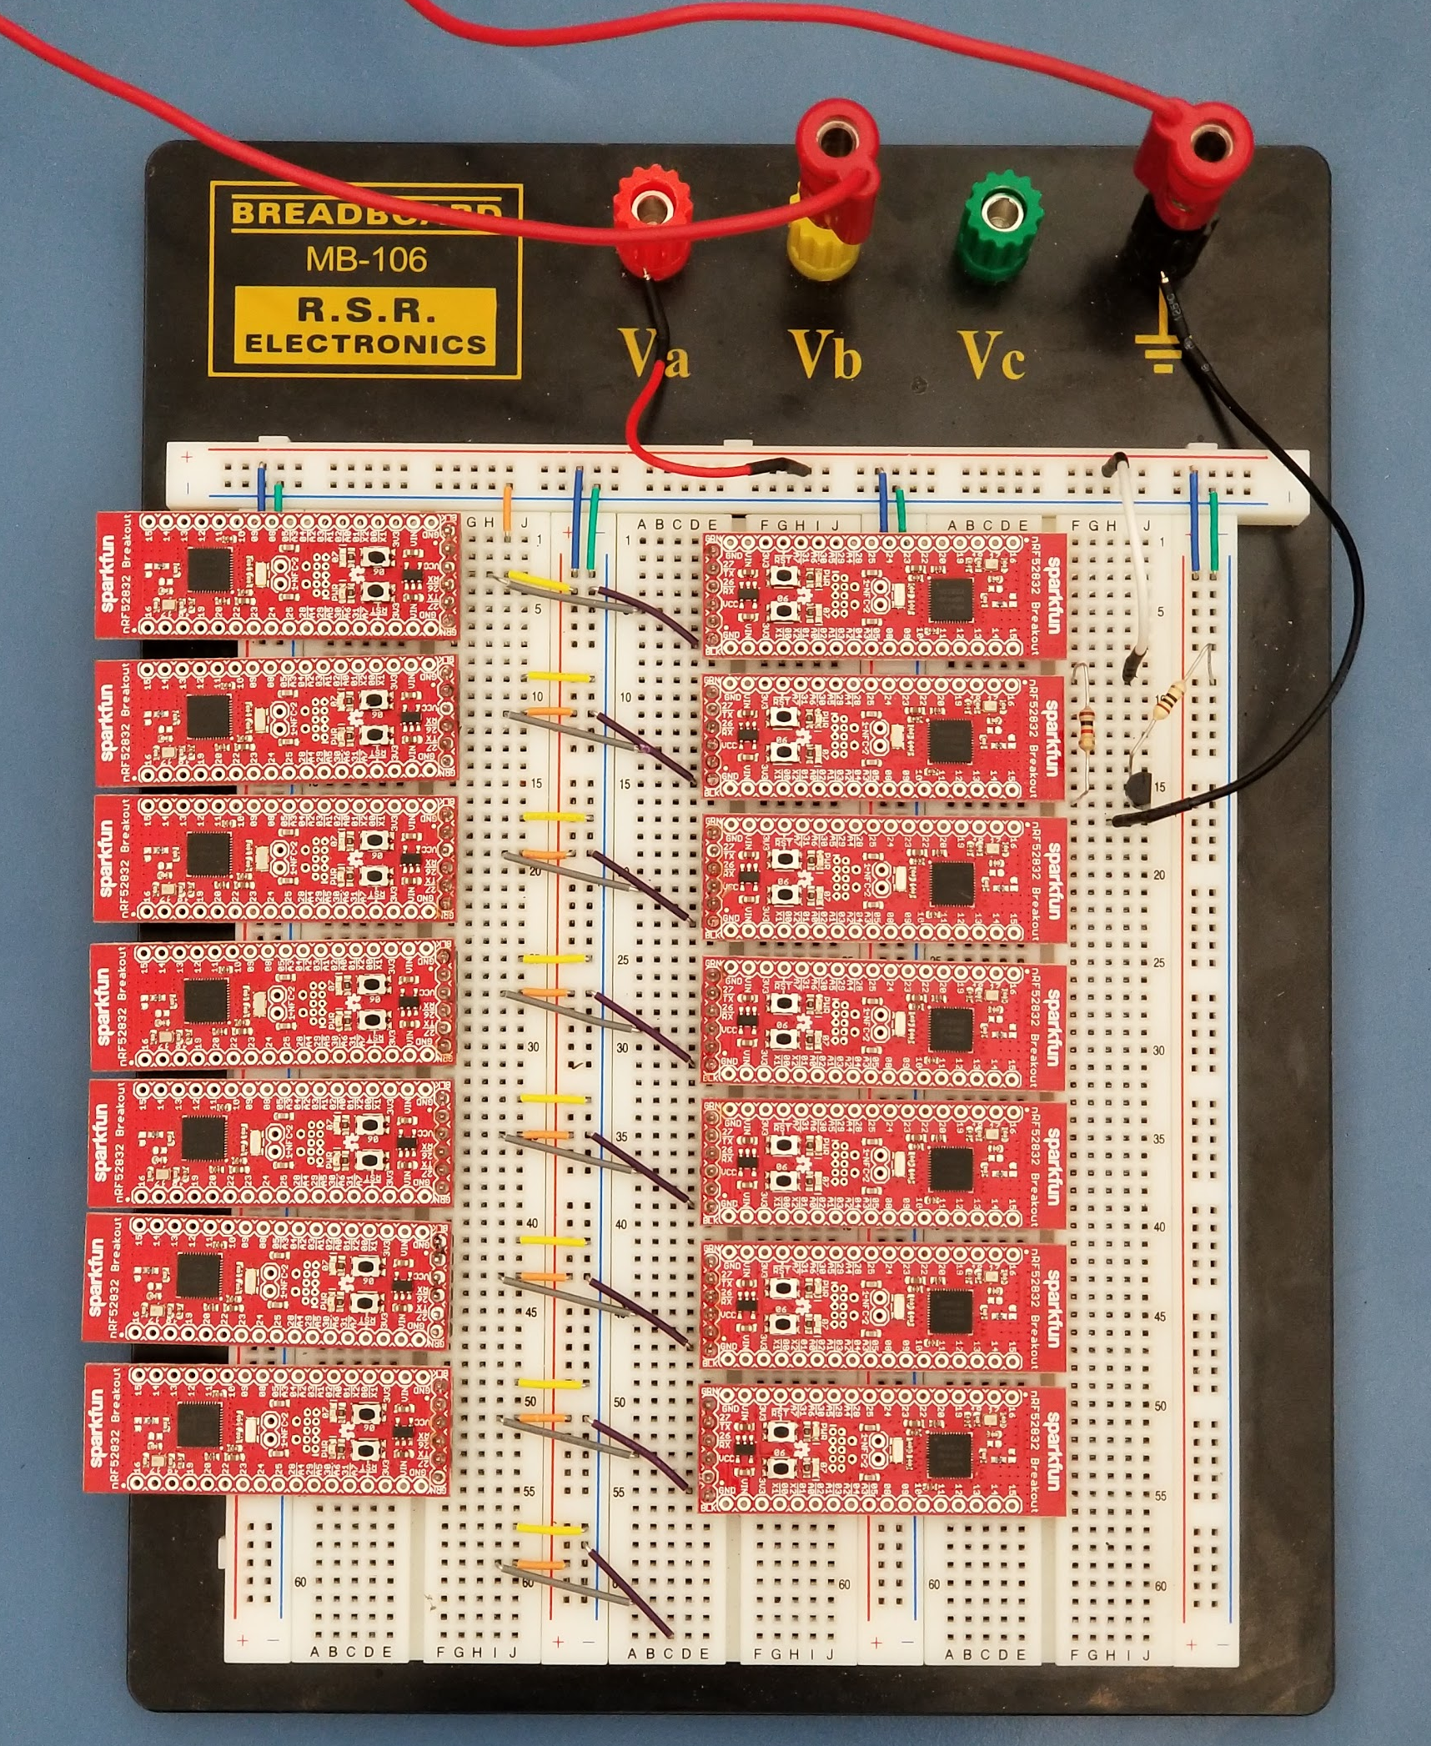
Tags Testing Setup
Notes:
Presenter: Matt

Slide 53
Power Budget
Power | Activity | Datasheet | Measured
nRF (Bluetooth) | Active | 13 mW | 16 mW
PIC | Sleep | 1𝜇W | 65𝜇W
 | Active | 0.5 mW | 1.5 mW
Tag average power | Active 1 sec/hour | 4.8 𝜇W | 68 𝜇W
 | Active 2 sec/hour | 8.5 𝜇W | 73 𝜇W
Battery life with 800mAh alone | Active | 6 days | 5 days
 | Active 2 sec/hour | 26 years | 3 years
Notes:
Presenter: Enrique
Assuming

Slide 54
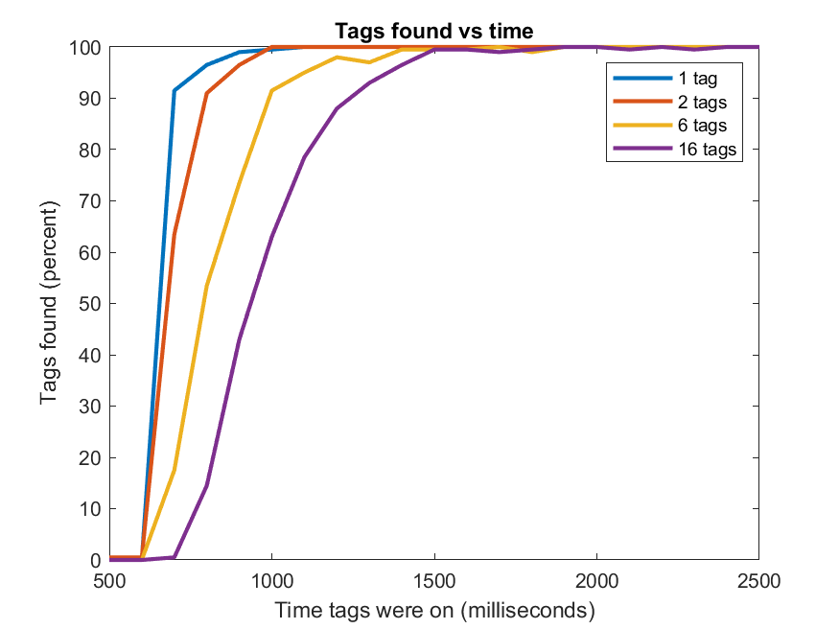
Communication Results: Time Tests (0 meters)
Notes:
Presenter: Enrique

Slide 55
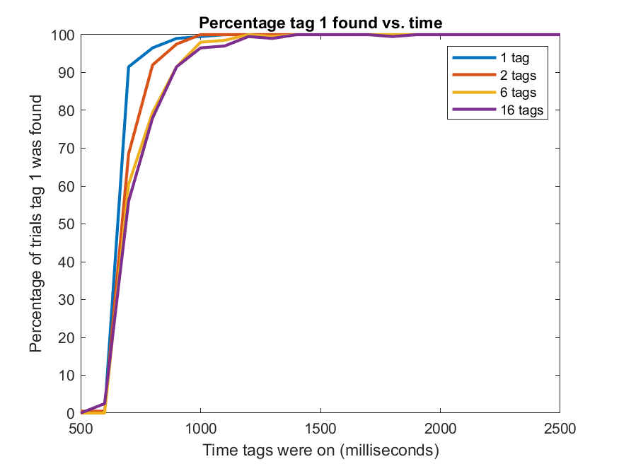
Communication Results: Time Tests (0 meters)
Notes:
Presenter: Enrique

Slide 56
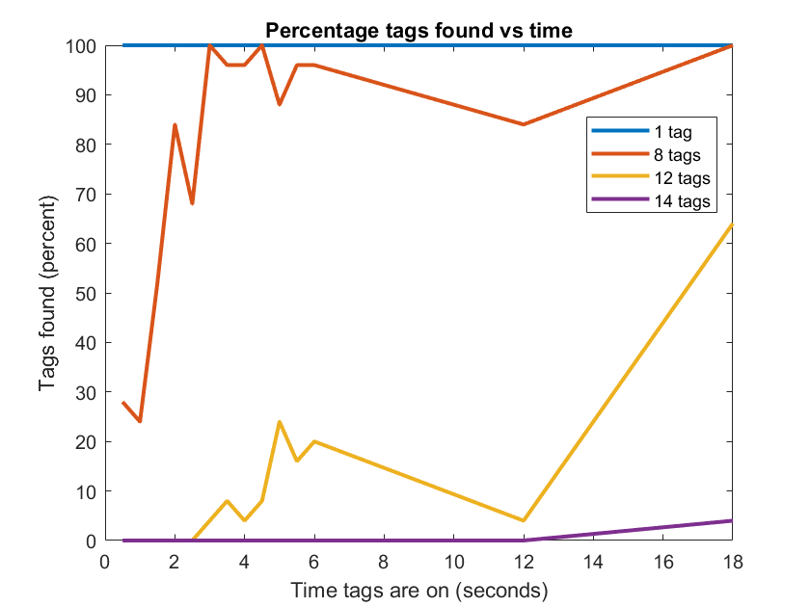
Communication Results: Time Tests (10 meters)
Notes:
Presenter: Enrique

Slide 57
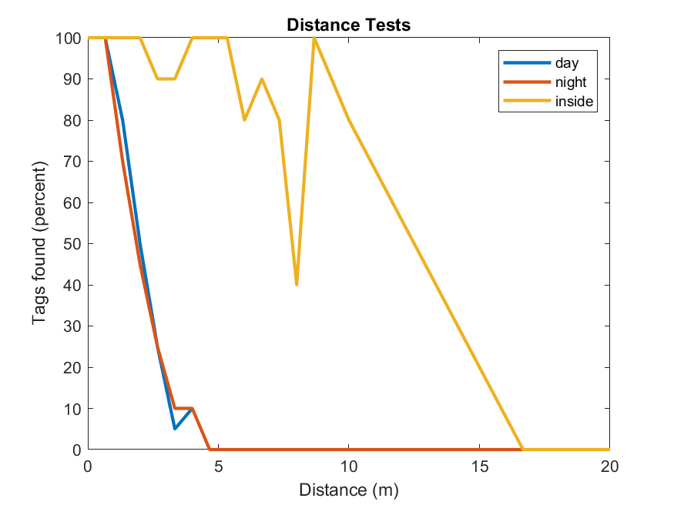
Communication Results: Distance Tests (6 tags)
Notes:
Presenter: Nikita

Slide 58
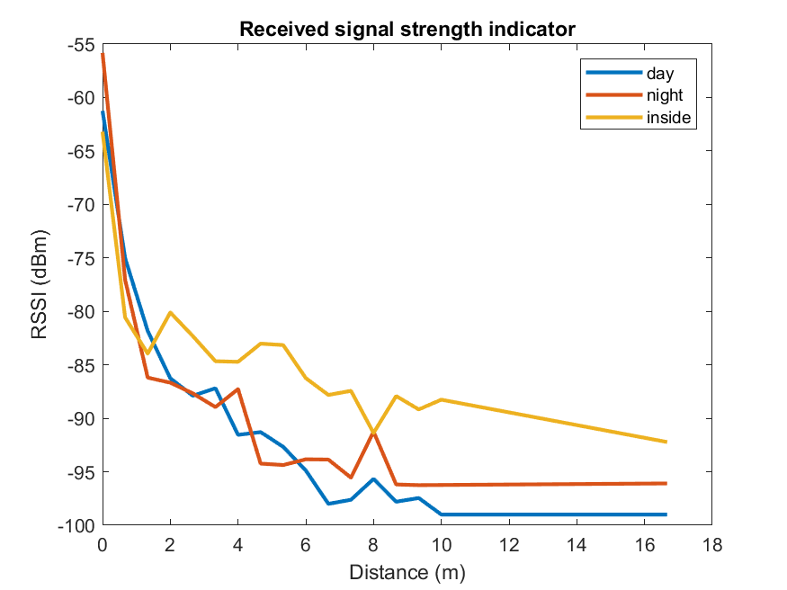
Communication Results: Distance Tests (6 tags)
Notes:
Presenter: Nikita

Slide 59
Communication Results: Summary
Can gather 100% of tag data at 15 meters indoors
The percentage quickly drops off outside
Longer scan times improve the percentage
Average RSSI:
0 meters: -50dBm to -60 dBm
10 meters: -90dBm to -100 dBm
Solutions:
Better receiving antenna
Stronger Signal
Obstacle Test:
Lowers Distance
Metal Studs
Notes:
Presenter: Nikita

Slide 60
PIC Results
Sleep mode: low power and watchdog timer
External interrupt: wireless pin interrupt
Most time in sleep
Average sleep power: 65 𝜇W
Average awake power: 1.5 mW
Notes:
Presenter: Matt
Maybe include something about how the pin interrupt works. Watchdog timer
3mJ 6

Slide 61
Results: Summary
Problems:
PIC uses more power than expected
Tags need longer transmitting time
Background noise outside is interferes more with the signal than expected
Resolutions:
Optimize program for PIC
Stronger Signal
Better Receiving Antenna on nodes
Design SOC with desired communication
Notes:
Presenter: Matt
System on a chip, combine nRF microcontroller w/ PIC or whateva, reduce by ~0.5s nRF

Slide 62
Overall Results In Comparison to Specs
Specification | Ideal | Measured
Communications Range | Tag to Nodes: 10 m | 15 m (indoors) 13 m (outdoors)
Power Usage | < 5 𝜇W | 73 𝜇W
Scalability | 100 Tags per node | >150 tags
Emergency Interrogation Signal | < 5 min | 3 min 25 seconds @ 3 meters
Notes:
Presenter: Austin

Slide 63
Skills Learned and Innovation
Skills Learned
Design
Programming with MPLab-X IDE
Experience with BLE
Power saving methods
Innovation
Scanning device IDs rather than device-to-device connections
Wireless pin interrupt
Notes:
Presenter: Matt - Add more to this
Weaknesses and strength of BLE: Bluetooth handshake, bluetooth connection limits
Power saving methods: Sleep cycle
Power Usage:
High listening power usage
Minimized transmission time*
Microcontroller active time

Slide 64
Questions?

Slide 65
Node Team
Thomas Dearing, Duggan Matson, Brendan Noone
Notes:
Presenter: Tommy

Slide 66
Subsystem Introduction: Nodes
MARS is a Supervisory Control and Data Acquisition (SCADA) system composed of a self-powered distributed data collection and sensor network.
NODES are mobile, mesh-networked sensors which...
Collect local tag inventories (type and location)
Report local inventory to UI server
Coordinate packets from other Nodes
Provide power to asset Tags
Notes:
Presenter: Tommy
Peer-to-Peer Fully Functional Devices by 802.15.4

Slide 67
Full System Model
Notes:
Presenter: Tommy

Slide 68
Node Subsystem
Notes:
Presenter: Tommy

Slide 69
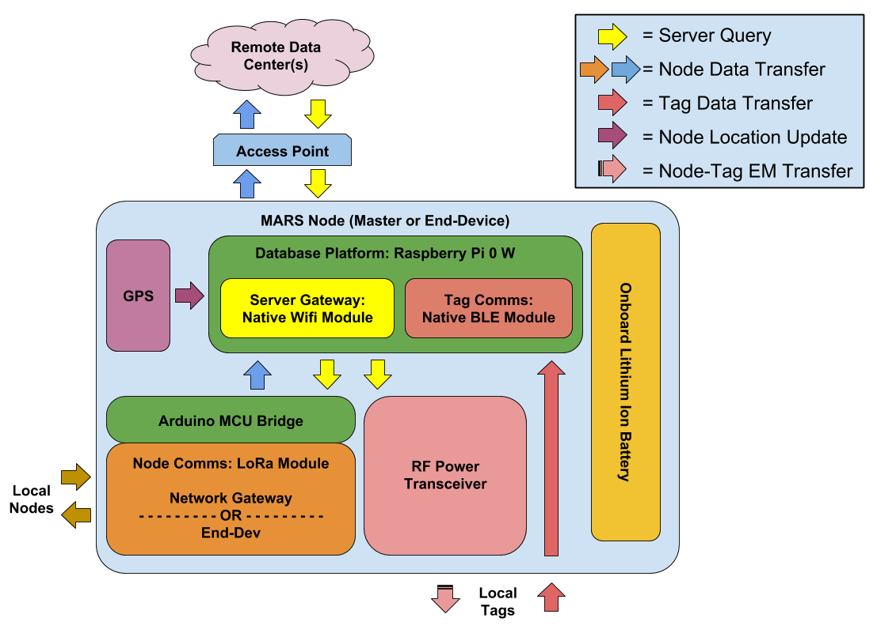
Subsystem Overview
Notes:
Presenter: Tommy

Slide 70
Subsystem Specifications
Specification | Value | Description
Communications Range | To Tags: 10 m To Nodes: 100 m To Gateway: 100 m | Minimum operating range
Positioning Error | < 10 m | Minimum location error
Runtime | 18 Hours | Minimum uptime between charges at 100% load
Tag Update Period | 5 min | Minimum inventory update period
Scalability | 100 Tags & Nodes | Minimum number of connections per Node
Mobility | Volume: < 300 cm³ Weight: < 250 g | Maximum dimensions/mass to easily carried/worn
Notes:
Presenter: Duggan

Slide 71
Decision Matrix: Hardware Development Platform
Platform | INSTR/s | Memory | Power Usage (Idle) | Max Power Usage | Software Availability | Total
Raspberry Pi 3 | 10 | 10 | 1 | 1 | 10 | 130
Raspberry Pi Zero W | 9 | 9 | 8 | 8 | 9 | 188
Beaglebone Black | 9 | 9 | 4 | 5 | 8 | 149
ESP32 | 5 | 7 | 10 | 10 | 4 | 164
Arduino 101 | 6 | 5 | 10 | 10 | 3 | 156
Arduino Uno | 3 | 3 | 7 | 9 | 3 | 116
Weight (1-5) | 4 | 4 | 5 | 5 | 4
Notes:
Presenter: Duggan

Slide 72
Decision Matrix: Location & Timing Services
Location & Timing Service | Price | Update Rate | Accuracy | Weight | Total
RB-EAG-11 | 1 | 1 | 5 | 9 | 48
Quadrino GPS i2c Module | 4 | 10 | 5 | 1 | 65
Ublox NEO-M8N GPS | 10 | 1 | 8 | 2 | 67
MT3329 GPS Module | 10 | 1 | 1 | 6 | 40
Adafruit 66 Channel v3 | 9 | 10 | 10 | 10 | 118
Weight (1-5) | 2 | 3 | 5 | 2
Notes:
Presenter: Duggan

Slide 73
Decision Matrix: Power Subsystem
Part Name | Capacity | Volume | Interface | Price | Total
PowerCore 13000 | 10 | 9 | 10 | 8 | 101
PowerCore 10000 | 9 | 10 | 9 | 9 | 104
KMASHI 10000mAh Portable Power Bank | 9 | 8 | 10 | 10 | 97
Weight (1-5) | 3 | 5 | 1 | 2
Notes:
Presenter: Duggan

Slide 74
Collaborative Design Decisions
Communications protocols:
Node-Tag: Bluetooth Low Energy
Node-Node-Gateway: LoRa
Software development platform: Node.js
Notes:
Presenter: Duggan
Be sure to mention that we did research Node-Node protocols but came to the same conclusion as the UI server

Slide 75
Engineering Standards & Ethical Considerations
Communications Protocols:
Bluetooth (IEEE 802.15.1)
LoRa-WPAN (IEEE 802.15.4)
Emission Safety Regulations:
Unlicensed RF emissions (FCC Title 47)
Usage and interference in ISM bands (IEEE 802.11)
Safety for on-body WBAN devices (IEEE 802.15.6)
Information Standards:
Geographic location (ISO 6709)
Standardized date and time (ISO 8601)
Standards for Deployment (Phase 2):
Military testing regulations (MIL-STD-810)
Notes:
Presenter: Brendan
Be sure to mention that this is only a subset of the standards we considered:
Comms protocols
802.15.1 - Bluetooth
802.15.4 - Specifies limitations for low power sensor networks (Low-Rate Wireless Personal Area Networks)
Up to 16 Physical Layer channels worldwide in 2.5 GHz band
Safety
FCC Title 47 - Provides guidelines on allowable RF emissions
802.11 - Specifies limitations on usage and expected interference in ISM bands
802.15.6 - Regulates wireless networking for embedded devices (Wireless On-Body Personal Area Networks)
Information
6709 & 8601 - govern the representation of GPS date and time
Deployment
MIL-STD-810 - standard military testing regulations for conditioning for application environment

Slide 76
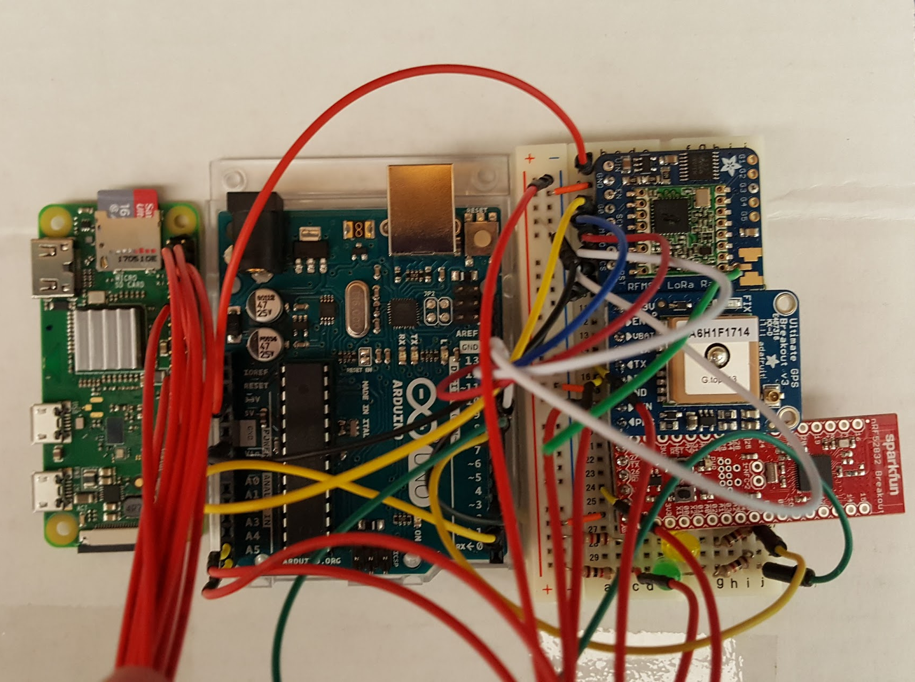
Results: Node Prototype
Notes:
Presenter: Tommy

Slide 77
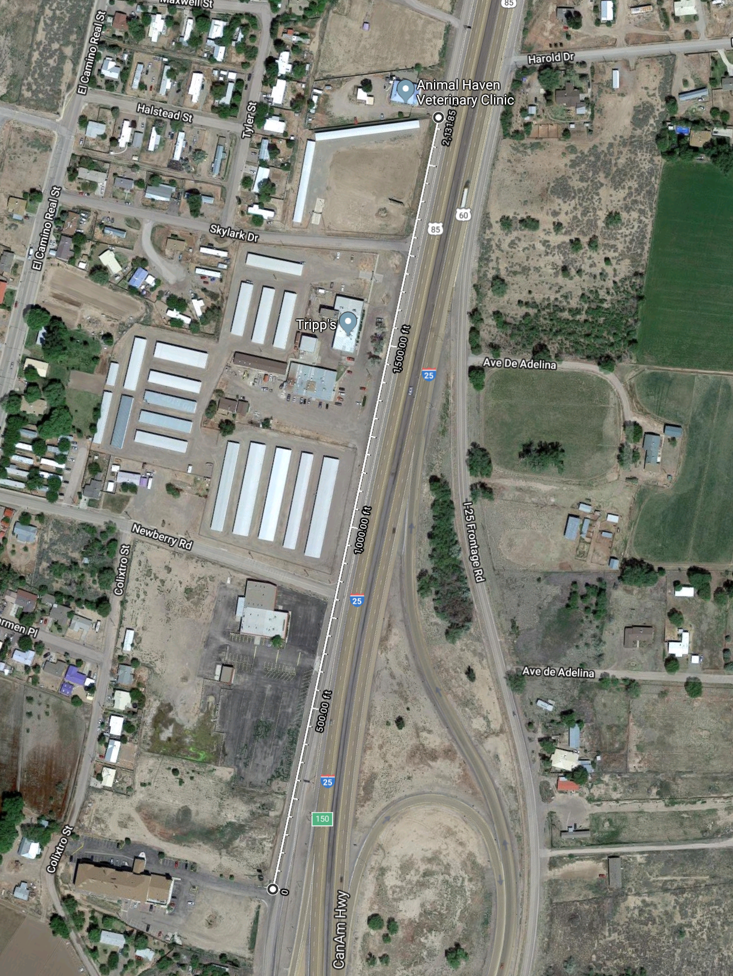
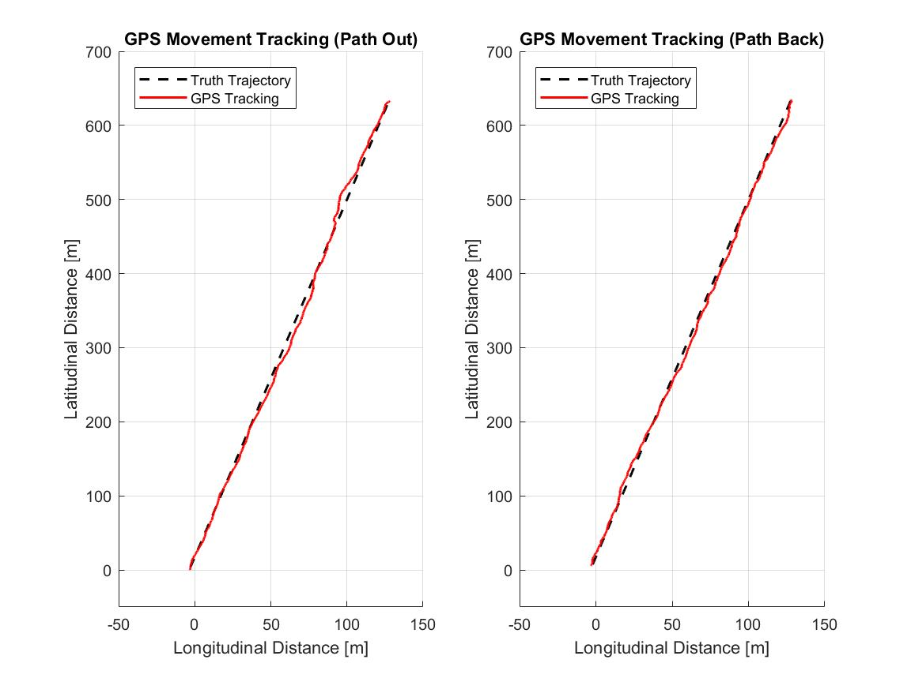
Results: GPS Characterization Tests
Notes:
Presenter: Tommy

Slide 78
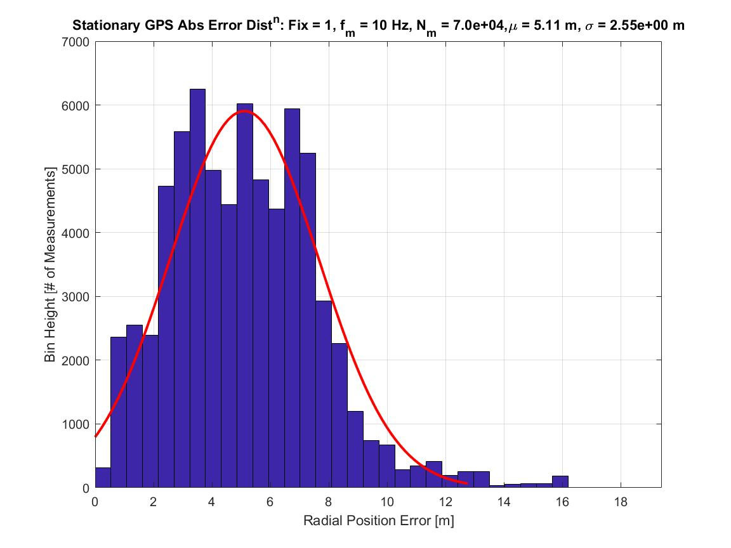
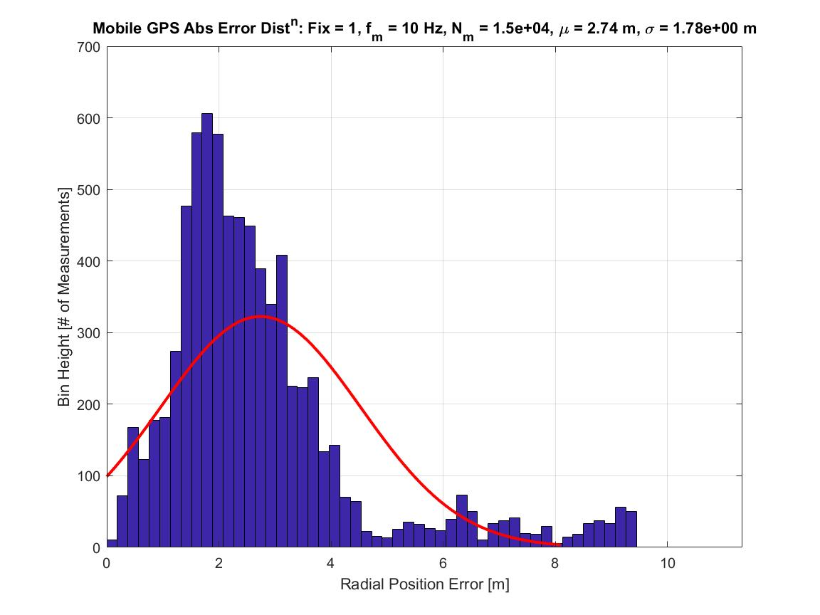
Results: GPS Tracking Error
Notes:
Presenter: Tommy

Slide 79
Results: GPS Tracking Error
Stationary Positioning Error (N_{sat} = 7):
Low FOV
Mean Error: 5.1 m < 10 m
95% CI Range: 10.2 m (2%) > 10 m
Mobile Positioning Error (N_{sat} = 10):
High FOV
Mean Error: 2.7 m < 10 m
95% CI Range: 6.3 m < 10 m
Using ISO 6709/8601 for reporting
Problems:
Error tolerance varies with N_{sat}
Estimate is a minimum value
Resolutions:
Aiding antenna used to increase N_{sat}
Require N_{sat} ≥ 10 on fix
Enabled tag triangulation
Notes:
Presenter: Tommy

Slide 80
Results: Runtime
18 H runtime on 10,000 mAH battery
2.78 W Max
Per-element maximal power usage:
Pi Zero (CPU Max): 1.25 W
Arduino Uno (Max): 0.40 W
GPS (Fixed): 0.07 W
BT & LoRa TRX: 0.73 W
RF Transmitter: 6.50 W
Current runtime at 7.6 h < 18 h
45 h w/o transmitter
Problems:
RF transmitter is inefficient
Resolutions:
Improve efficiency of power transfer
Establish battery charging rotation
Single board / MCU solution
Measured
1.1 W
Notes:
Presenter: Brendan
Per-element maximal power usage:
Pi Zero (CPU Max): 1.250 W
Arduino Uno (Max): 0.400 W
GPS (Fixed): 0.066 W
Bluetooth: 0.300 W
LoRa Module TRX: 0.330 W
LoRa Module RX: 0.099 W
RF Transmitter: 6.500 W (1.3A, 5V)
Battery holds 180 kJ

Slide 81
Results: Communications Ranges
Node-Tag: BLE
Indoor LOS: > 15 m 0% Loss
Outdoor LOS: > 13 m 0% Loss
Node-Node-Server: LoRa
Indoor LOS: < 50 m 0% Loss
Indoor OBS: < 50 m 0% Loss
Outdoor LOS: <120 m 0% Loss
>230 m 35% Loss
Outdoor OBS: Obstruction dependent
Problems:
Tags transmission distance outside
LoRa blocked by large buildings
Resolutions:
Add external receiving antenna
Determine building size / construction and consider in deployment
Notes:
Presenter: Brendan
Line-Of-Sight and Obstructed

Slide 82
Results: Asset Update Period, Scalability, & Mobility
Asset ID / location update time
Routing length: 10 Nodes
1-Node routing time: 411 ms
Max routing delay: 4.11 s << 1 hr
Functional Req. of 100 Nodes / Gateway
120 Nodes / Gateway at 10% Net loss
Prototype Size & Weight
Size: 270 cm³ < 300 cm³
Weight: 247 g < 250 g
Notes:
Presenter: Brendan
Assuming maximal range / area coverage for a set of 100 nodes, the maximal direct routing path to the server will be through 10 Nodes w/ 411 ms per routing Node
Reference for max device count:
https://www.researchgate.net/publication/310200794_Do_LoRa_Low-Power_Wide-Area_Networks_Scale
Approximate Node dimensions:
9x6x5 cm
Want image of prototype to fill space

Slide 83
Results: Summary
Specification | Ideal Value | Measured
Communications Range | To Tags: 10 m To Nodes: 100 m To Gateway: 100 m | 13 m 120 m 120 m
Positioning Error | 10 m | 6.5 m
Runtime | 18 hrs | 7.6 hrs
Tag Update Period | 5 min | 4 s
Scalability | Tags: 100 Nodes: 100 | 100 120
Mobility | Volume: 300 cm³ Weight: 250 g | 270 cm³ 247 g
Notes:
Presenter: Tommy

Slide 84
Skills and Technical Innovations
Skills Developed:
Iterative Design
Project management and leadership
Development of a functional Ad-Hoc mesh sensor network
Development of a GPS accuracy characterization protocol
Protocols: JSON, LoRa, and BLE
Innovative Design Element:
LoRa Mesh Network (Coop with UI/Server Team)
Notes:
Presenter: Tommy

Slide 85
Questions?
Notes:
Presenter: All

Slide 86
UI/Server Team
Courtney Bamonte, Dominic Borunda, Zach Harris, Christopher Rey
Notes:
Courtney

Slide 87
Subsystem Introduction: UI/Server
MARS is a Supervisory Control and Data Acquisition (SCADA) system composed of a self-powered distributed data collection and sensor network.
The User Interface and Server is an interactive interface which sends and receives information throughout MARS and allows the user to access specific and systemwide data.
Notes:
Dom
Talk about why we are doing this

Slide 88
Design Goals
Robust server to collect and store information
Organize display for easy asset discovery
Reliable communication to battlefield
Resilient network structure
Optimize data packetization
Notes:
Dom

Slide 89
Full System Model
Notes:
Courtney

Slide 90
Server Subsystem
Notes:
Courtney

Slide 91
Subsystem Specifications
Specification | Value | Description
Communications Range | To Nodes: 100 m To Gateway: 100 m | Minimum operating range for protocol
Positioning Error | < 10 m | Minimum location service error for tag triangulation
Hardware Scalability | 100 Nodes w/ 100 Tags | Minimum number of connected devices per Node
Server Scalability | 100 Nodes w/ 100 Tags each | Minimum number of connected devices server can handle
Throughput | 10 kbps | Minimum network load
UI Functions | Tag Triangulation Interrogation Signal | Minimum functional applications on UI
Notes:
Zach:
Reactive and intuitive user interface
Real-time processing

Slide 92
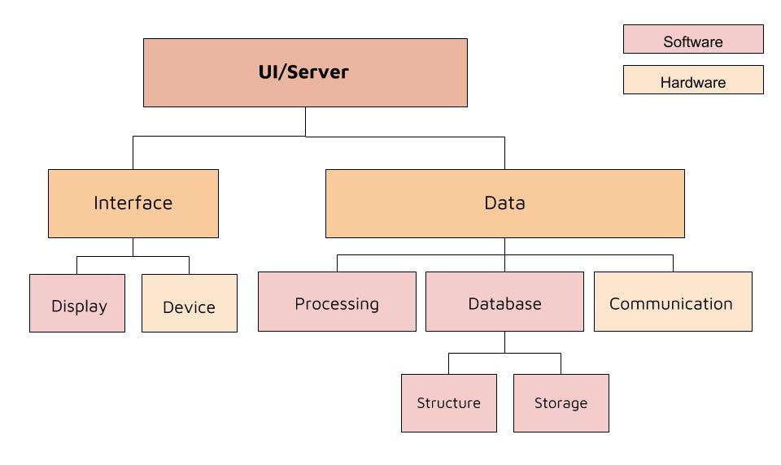
Design Breakdown
Notes:
Chris
Communication - Communication relies on the quick update of information for real-time diagnostics and inventory, routine communications with the nodes to sense for disconnection, and a transmit/receive model to send interrogation signals and receive information.
Data Management - Data management, as a whole, incorporates storage for a backlog on information, a set data structure, quick processing time, and a way to index the values.
User Interface - User interface tabulates the data, incorporates advanced search routines, triangulates approximate location of tags, and displays system metrics in an understandable format.

Slide 93
Decision Matrix: Server to Node Communication
 | UI | Performance | Modularity | Reactivity | Feasibility | Total
HTTP | 2 | 8 | 2 | 6 | 2 | 90
Golang | 2 | 10 | 4 | 6 | 6 | 118
NodeJS | 10 | 6 | 10 | 10 | 10 | 180
Qt | 2 | 10 | 10 | 2 | 6 | 116
Vert.x | 6 | 6 | 8 | 10 | 8 | 152
Weights (1-5) | 4 | 5 | 3 | 5 | 3
Notes:
Zach
DDP

Slide 94
Decision Matrix: Gateway Node to Node Communication
 | Range | Data Rate | Network Size | Power | Total
Zigbee | 3 | 5 | 9 | 8 | 88
6LoWPAN | 3 | 5 | 2 | 9 | 79
Z-Wave | 4 | 3 | 8 | 7 | 80
LoRa | 10 | 1 | 7 | 5 | 92
Ethernet | 5 | 10 | 1 | 1 | 62
Weights (1-5) | 5 | 3 | 2 | 5
Notes:
Courtney

Slide 95
Decision Matrix: Data Management and Storage
 | Structure | Accessibility | Feasibility | Total
Text File | 2 | 3 | 10 | 77
SQL | 6 | 10 | 7 | 91
MongoDB | 9 | 10 | 10 | 115
Weights (1-5) | 5 | 4 | 3
Notes:
Chris
Update Matrix:
Relational Database (SQL)
Relational Database groups data by type
Document-Oriented Database (MongoDB)
Groups data into documents

Slide 96
Engineering Standards & Ethical Considerations
Emissions and Communications Protocols:
Unlicensed RF emissions (FCC Title 47)
LoRa-WPAN (IEEE 802.15.4)
Usage and interference in ISM band (IEEE 802.11)
Information Standards:
GPS Location (ISO 6709)
Time and Date (ISO 8601)
Notes:
Zach
IEEE 802.15.6 - standardizes wireless networking for wearable and embedded devices, and gives range, low power, and data rates.
FCC Title 47 - outlines the federal guidelines on radio frequency communications and emissions.
MIL-STD-810 - Since this system is intended for military use, the military standard for testing
ISO 6709 and 8601 - represent the standards for GPS data and the representation of time and date, respectively.

Slide 97
Data Flow Diagram
Sensor 1
Tag Data
Sensor 2
Node Data
Server Database
GPS
Metadata
Timestamp
Notes:
Chris

Slide 98
Data Flow Diagram
4 bytes
8 bytes / measurement
4 bytes
24 bytes / measurement
72 bytes / message
8 bytes
48 bytes
8 bytes
Notes:
Chris

Slide 99
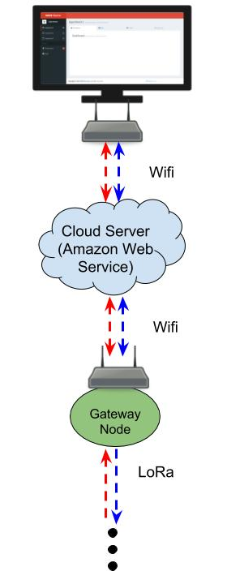
Communication Results: Server to Node
Server running on specific computer
Interrogation signals initiate on UI through server
Data is collected and updates the database from the network
Network is constantly ready to receive data
Notes:
Dom
Maybe use diagrams instead of text here

Slide 100
Communication Results: Node to Node
LoRa mesh network
Nodes propagate interrogation signals to correct node address
Nodes alternate between receiving and transmitting for data relay
Stop signal to end transmissions
Notes:
Courtney
Maybe use diagrams instead of text here

Slide 101
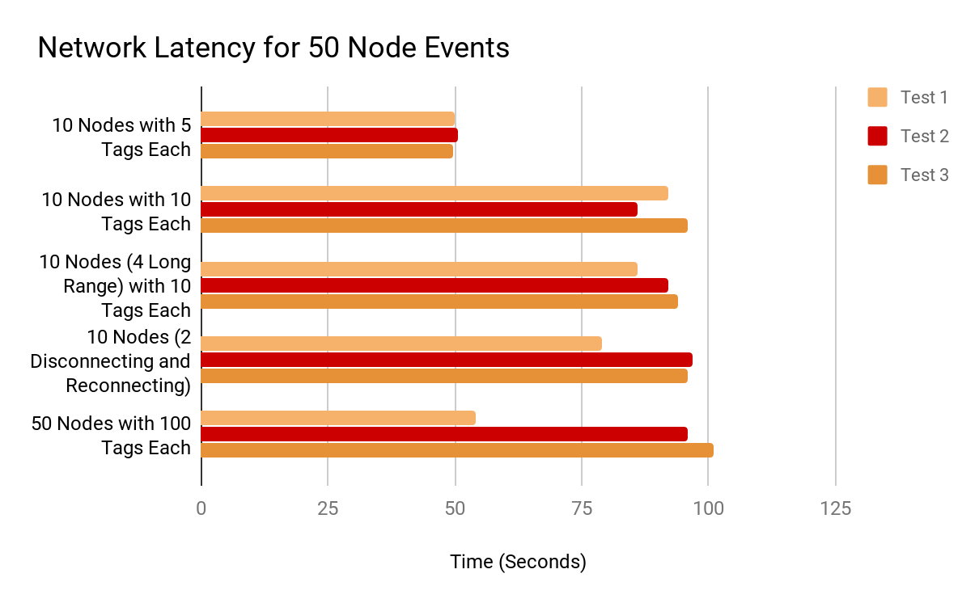
Data Management Results: Network Collection Time
Notes:
Courtney
TODO: incorporate other network performance slide
Talk about the different tests we ran
Recommendation from these findings that for 100 nodes and 100 tags each, would need two servers

Slide 102
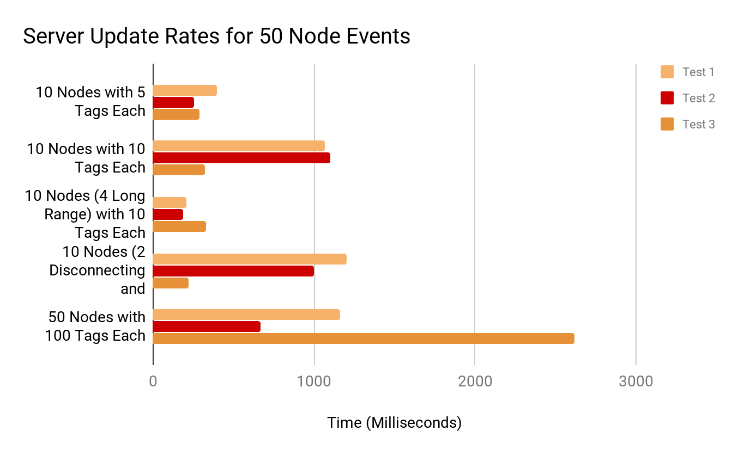
Data Management Results: Server Update Rate
Notes:
Courtney

Slide 103
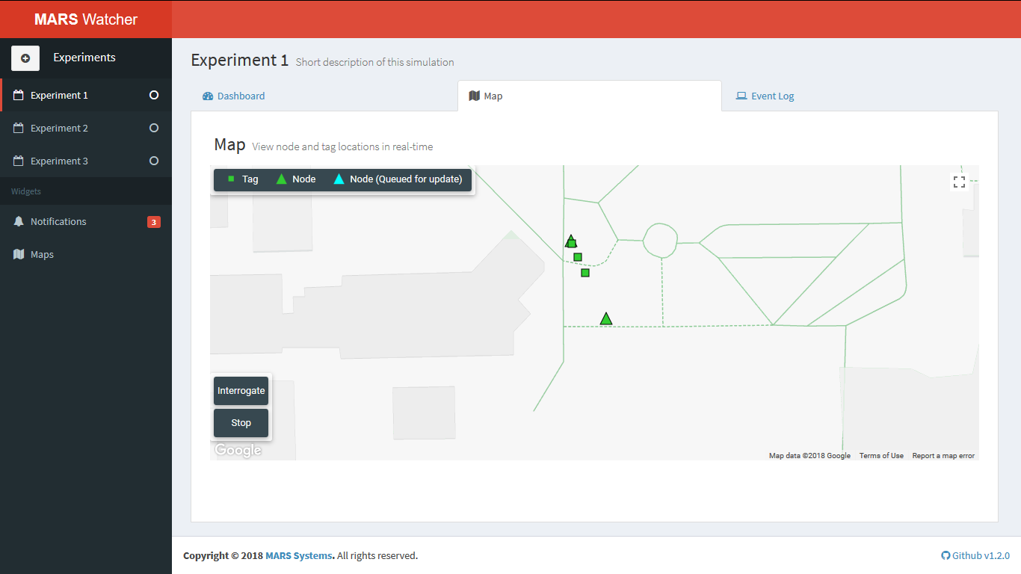
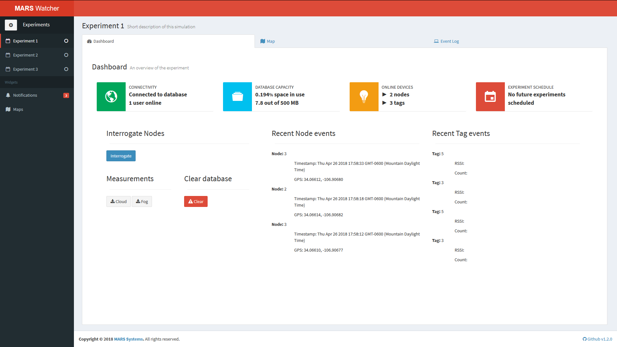
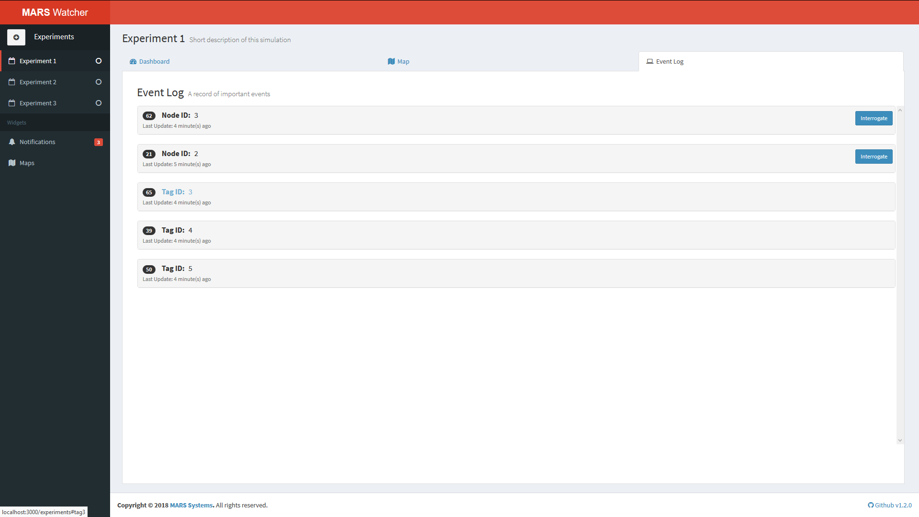
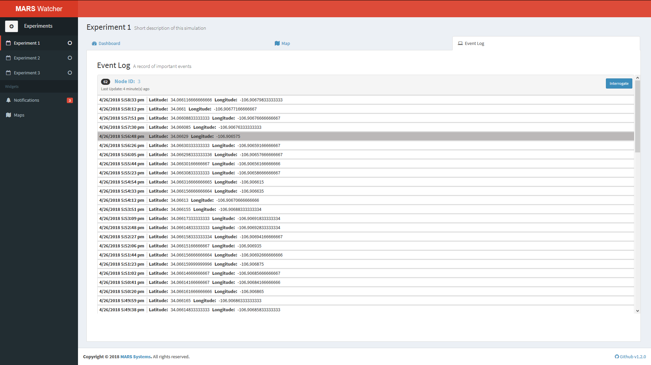
User Interface Results
Notes:
Chris
Animated Slide: showing the various UI pages

Slide 104
Results
UI/ Server
Server can reliably handle ~80 nodes and 100 tags per node
UI updates reactively to changes in the server database
Communication
Gateway nodes are able to packetize and send data from other nodes and tags in the network
Server is able to parse and sort packets received by gateway nodes
Problems:
UI latency increases significantly for large numbers of incoming data packets.
Extra signal propagation between nodes
Resolutions:
More robust server for increased network size
Stop signal to end signal “bouncing”
Notes:
Zach

Slide 105
Results Summary
Specification | Ideal Value | Measured
Communications Range | To Nodes: 100 m To Gateway: 100 m | 120 m 120 m
Positioning Error | 10 m | 6.5 m
Hardware Scalability | Tags: 100 Nodes: 100 | 100 120
Server Scalability | Tags: 100 / Node Nodes: 100 / Gateway | 100 Tags per Node < 81 Nodes
Throughput | 10 kbps | > 10 kbps
UI Functions | Tag Triangulation Interrogation Signal | Functional Functional
Notes:
Zach:
Reactive and intuitive user interface
Real-time processing

Slide 106
Skills Learned and Innovation
Skills Learned
Project Design
Interacting with Google Maps and Web design
Developed packetization scheme for gateway to server communication
Implementation of NodeJS and MongoDB
Developed functional Ad-Hoc mesh sensor network
Work with LoRa
Languages: Javascript, HTML, Python, and C
Innovations:
LoRa Mesh network for Node to Node communication (Co-op with Node Team)
Interrogation scheme from UI
Notes:
Dom

Slide 107
Questions?

Slide 108
Results
Courtney Bamonte, Nikita Belooussov, Thomas Dearing, Albert Reed

Slide 109
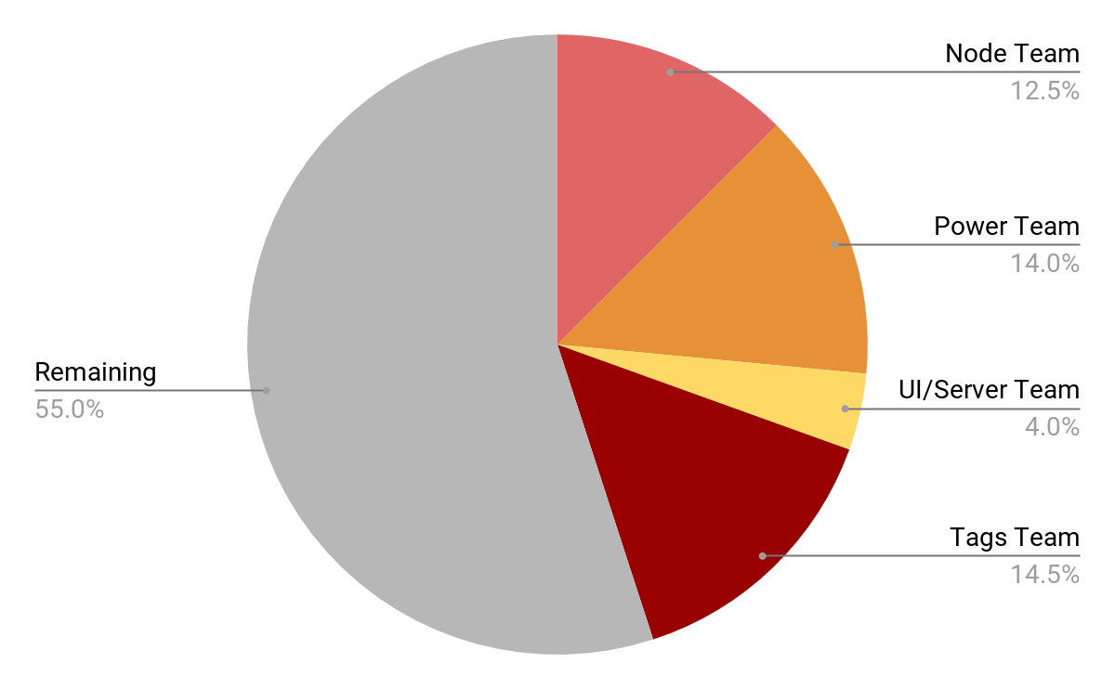
Budget: Used $1800 / $4000
Notes:
Albert

Slide 110
Operation/Implementation
Notes:
Courtney

Slide 111
MARS Performance Summary
Specification | Desired Value | Measured
Communications Range | To Tags: 10 m To Nodes: 100 m To Gateway: 100 m | 13 m 120 m 120 m
Maintenance Period | Tags: > 1 year Nodes: > 18 hours | 3 years 7.6 hours
Monitor Update Period | Normal: 1 hr Emergency: 5 min | Configurable 4 min @ 3 m
Node Scalability | 100 Tags & Nodes | 100 Tags, 120 Nodes
Server Scalability | Tags: 100 / Node Nodes: 100 / Gateway | 100 Tags per Node < 81 Nodes
Positioning Error | < 10 m | 6.5 m
Notes:
Nikita

Slide 112
Full System Test & Functional Demonstration
Network Demonstration
1 Gateway Node
3 Nodes
2 Interrogation Tags
4 Moving/routine update Tags
Power Scavenging Demonstration
Power scavenging to charge battery
Notes:
Courtney

Slide 113
Project Achievements
Successful implementation of a Distributed Sensor Network
Scalable system prototype for 1000+ Tags and 80+ Nodes
Successful RF scavenging system to supplement Tag lifetime
Met design criteria for implementation in Battlefield environment
Final conclusion: MARS concept is an Outstanding Success
Notes:
Tommy

Slide 114
Other MARS Applications
Commercial inventory applications (Warehouses)
Mail tracking
Smart inventory system
Mobile sensor network
Notes:
Nikita

Slide 115
Questions?

Slide 116
Demonstration

